Slide 1


National Higher School of Autonomous Systems Technology
Department of Preparatory Classes
2nd Preparatory year
Chemistry 4
Dr. IK Benramdane

Slide 2
Chapter 1 :
Nomenclature of organic compounds

Slide 3

Chemistry is the science that studies the various constituents of matter, their properties, transformations, and interactions. It has different branches:
⎯ Analytical chemistry. ⎯ Inorganic chemistry. ⎯ Organic chemistry (which we will present). ⎯ Physical chemistry.
So, what is organic chemistry?
Organic chemistry is the branch of chemistry that studies organic compounds, meaning carbon-containing compounds, which can be either natural or synthetic.
Organic molecules frequently contain hydrogen atoms and often include oxygen or nitrogen atoms, while synthetic molecules are often derived from petroleum.
Notes:
Here are some simple examples of organic compounds that contain oxygen (O) and/or nitrogen (N):
With oxygen (O):
Ethanol (C₂H₅OH) → Found in alcoholic beverages.
Glucose (C₆H₁₂O₆) → A sugar essential for energy.
Acetic acid (CH₃COOH) → The main component of vinegar.
With nitrogen (N):
Methylamine (CH₃NH₂) → Used in organic chemistry.
Urea (CH₄N₂O) → A metabolic waste product in urine.
Adenine (C₅H₅N₅) → A nitrogenous base in DNA.
With both oxygen and nitrogen (O and N):
Acetamide (CH₃CONH₂) → A simple amide.
Aspartic acid (C₄H₇NO₄) → An essential amino acid.
Caffeine (C₈H₁₀N₄O₂) → Found in coffee and tea.

Slide 4
Organic chemistry specifically studies their chemical structure, properties, characteristics, chemical composition, chemical reactions, and preparation.
What makes them unique (polar or non-polar, electrical conductivity, aromas, etc.).
How atoms are arranged in the molecule (single, double, and triple bonds, molecular shapes)
How these molecules interact with their environment (solubility, boiling point, toxicity, etc.)
Which elements compose them and in what proportions.
Example: Glucose (C₆H₁₂O₆) contains carbon, hydrogen, and oxygen.
How they interact with other substances to form new products.
Example: The combustion of methane produces carbon dioxide and water
(CH₄ + 2 O₂ → CO₂ + 2 H₂O)
How they can be synthesized in the laboratory or extracted from natural sources.
Example: Aspirin is synthesized from salicylic acid and acetic anhydride.
Notes:
Here are some simple examples of organic compounds that contain oxygen (O) and/or nitrogen (N):
With oxygen (O):
Ethanol (C₂H₅OH) → Found in alcoholic beverages.
Glucose (C₆H₁₂O₆) → A sugar essential for energy.
Acetic acid (CH₃COOH) → The main component of vinegar.
With nitrogen (N):
Methylamine (CH₃NH₂) → Used in organic chemistry.
Urea (CH₄N₂O) → A metabolic waste product in urine.
Adenine (C₅H₅N₅) → A nitrogenous base in DNA.
With both oxygen and nitrogen (O and N):
Acetamide (CH₃CONH₂) → A simple amide.
Aspartic acid (C₄H₇NO₄) → An essential amino acid.
Caffeine (C₈H₁₀N₄O₂) → Found in coffee and tea.

Slide 5

History of Organic Chemistry
1. Before the 19th Century: The Vitalism Theory Before the 19th century, scientists believed that organic compounds (substances derived from living organisms) could not be synthesized artificially. This idea was based on the theory of vitalism, which suggested that a "vital force" unique to living beings was necessary to create organic substances.
2. 1828: Wöhler’s Urea Synthesis – The Fall of Vitalism In 1828, Friedrich Wöhler challenged the vitalism theory by synthesizing urea (an organic compound) from ammonium cyanate, an inorganic substance. This groundbreaking experiment demonstrated that organic compounds could be created in a laboratory without a "vital force," marking the birth of modern organic chemistry.
3. 19th Century: Structural Theories and Advances
Justus von Liebig and Friedrich Wöhler further developed the understanding of organic molecules. August Kekulé proposed the structural theory of chemical bonding, particularly the benzene ring structure (1865). Scientists began to classify organic compounds based on their functional groups and reactivity.

Slide 6
4. 20th Century: Industrial and Pharmaceutical Developments
The development of synthetic polymers (e.g., nylon, polyethylene) revolutionized materials science.
Advances in pharmaceutical chemistry led to the discovery of antibiotics (e.g., penicillin in 1928 by Alexander Fleming).
Organic reactions such as Grignard reactions, Friedel-Crafts reactions, and polymerization became essential in industrial chemistry.
5. Modern Organic Chemistry: Computational and Green Chemistry
The introduction of computational chemistry and spectroscopic techniques (NMR, IR, mass spectrometry) improved molecular analysis.
Green chemistry focuses on sustainable synthesis methods, reducing environmental impact.
Biotechnology and organic chemistry intersect in drug design, materials science, and nanotechnology.

Slide 7
Nomenclature
La nomenclature des composés chimiques est un ensemble de règles permettant de nommer les molécules de manière systématique. Elle est définie par l’Union Internationale de Chimie Pure et Appliquée (IUPAC).
Generally, the name consists of
Branches (substituents) main carbon chain double π C=C functional groups
In alphabetical order,
preceded by cyclo in the case of a cyclic chain
None: -ane
C=C: -ene
C≡C: -yne
See the priority order of functions
Notes:
Comment identifier la chaîne principale ?
Trouver la plus longue chaîne continue de carbone : Celle qui contient le plus grand nombre d'atomes de carbone en continu.
Prioriser les groupes fonctionnels : Si un groupe fonctionnel prioritaire (comme un acide carboxylique, un aldéhyde ou une cétone) est présent, la chaîne principale doit inclure ce groupe.
Choisir la chaîne avec le plus de ramifications : En cas d'égalité entre plusieurs chaînes de même longueur, on privilégie celle avec le plus de ramifications (substituants).

Slide 8
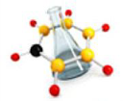
Introduction
A main carbon chain is the longest continuous chain of carbon atoms in an organic molecule. It serves as the base for naming the compound according to IUPAC nomenclature.
How to identify the main chain?
1- Find the longest continuous carbon chain:
It must contain the maximum number of carbon atoms connected without interruption.
2- If there is a tie, choose the chain with the most branches:
If multiple chains of the same length exist, the one with the most substituents (alkyl groups, halogens, etc.) is preferred.
Notes:
1. Selon la structure :
📌 Chaîne linéaire (ou normale)
Les atomes de carbone sont alignés sans ramification.
Exemple : Butane (CH₃-CH₂-CH₂-CH₃)
📌 Chaîne ramifiée
Contient une ou plusieurs ramifications (groupes alkyles).
Exemple : 2-Méthylpropane (CH₃-CH(CH₃)-CH₃)
📌 Chaîne cyclique (ou fermée)
Les atomes de carbone forment un cycle.
Exemple : Cyclohexane (C₆H₁₂)
2. Selon la saturation :
📌 Chaîne saturée
Contient uniquement des liaisons simples (C-C).
Exemple : Propane (CH₃-CH₂-CH₃)
📌 Chaîne insaturée
Contient au moins une liaison multiple (double C=C ou triple C≡C).
Exemple : Éthylène (CH₂=CH₂) → double liaison
Exemple : Acétylène (CH≡CH) → triple liaison
3. Selon la nature des atomes :
📌 Chaîne homocyclique
Constituée uniquement de carbone et hydrogène.
Exemple : Cyclohexane (C₆H₁₂)
📌 Chaîne hétérocyclique
Contient au moins un atome autre que le carbone (O, N, S…).
Exemple : Pyrrole (C₄H₅N)
Résumé :
Les chaînes carbonées se distinguent par leur forme (linéaire, ramifiée, cyclique), leur liaison (saturée, insaturée) et la présence ou non d'autres éléments chimiques.
4o
Types of Carbon Chains in Organic Chemistry
Carbon chains in organic compounds can be classified based on structure, saturation, and composition.
1. Based on Structure:
📌 Straight (linear) chain
Carbon atoms are connected in a continuous sequence without branches.
Example: Butane (CH₃-CH₂-CH₂-CH₃)
📌 Branched chain
Contains one or more branches (alkyl groups).
Example: 2-Methylpropane (CH₃-CH(CH₃)-CH₃)
📌 Cyclic (ring) chain
Carbon atoms form a closed loop.
Example: Cyclohexane (C₆H₁₂)
2. Based on Saturation:
📌 Saturated chain
Contains only single bonds (C-C) between carbon atoms.
Example: Propane (CH₃-CH₂-CH₃)
📌 Unsaturated chain
Contains at least one double (C=C) or triple (C≡C) bond.
Example: Ethylene (CH₂=CH₂) → double bond
Example: Acetylene (CH≡CH) → triple bond
3. Based on Composition:
📌 Homocyclic chain
Contains only carbon and hydrogen in the ring.
Example: Cyclohexane (C₆H₁₂)
📌 Heterocyclic chain
The ring contains at least one atom other than carbon (O, N, S, etc.).
Example: Pyrrole (C₄H₅N)
Summary:
Carbon chains can be classified by shape (linear, branched, cyclic), bond type (saturated, unsaturated), and atomic composition (homocyclic, heterocyclic).
4o

Slide 9
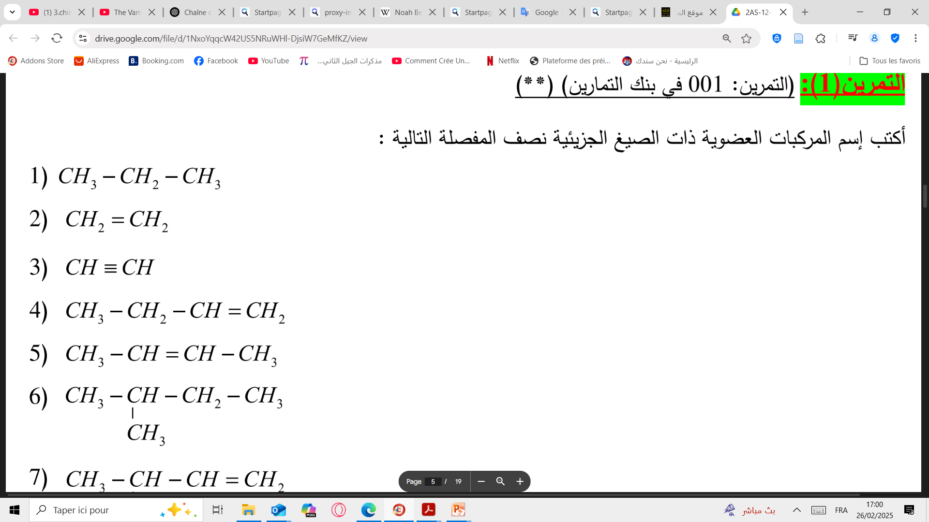
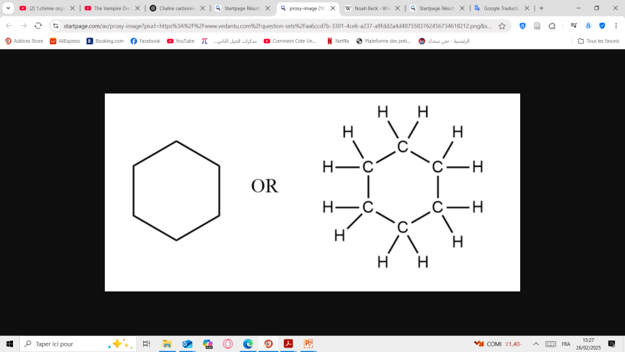
Introduction
Types of Main Chains in Organic Chemistry:
1. Based on Structure
Straight (linear) chain: Carbon atoms are arranged in a continuous sequence without branching. Example: Butane CH₃-CH₂-CH₂-CH₃
Branched chain: Contains one or more branches (alkyl groups).
Example: 2-Methylbutane
Cyclic (ring) chain: Carbon atoms form a closed loop. Example: Cyclohexane (C₆H₁₂)

Slide 10
Introduction
Types of Main Chains in Organic Chemistry:
Alkane
2- Based on Saturation:
Saturated chain: Contains only single bonds (C-C) between carbon atoms.
Example: Propane (CH₃-CH₂-CH₃)
Unsaturated chain: Contains at least one double (C=C) or triple (C≡C) bond.
Example: Ethylene (CH₂=CH₂) → double bond
Example: Acetylene (CH≡CH) → triple bond
Alkene
Alkyne

Slide 11
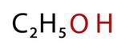
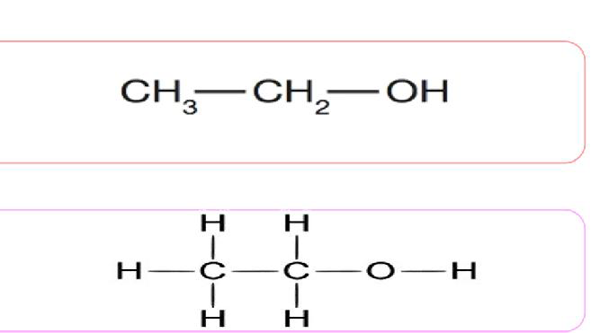
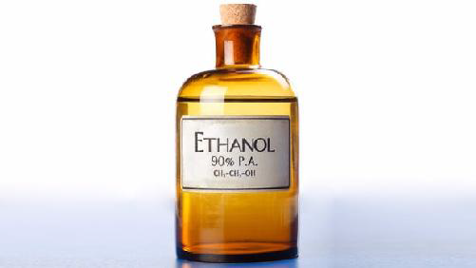
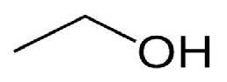
Introduction
Molecular formula:
Structural formula:
Condensed formula:
Skeletal formula
الصيغة المجملة
Representation of an organic molecule
الصيغة المفصلة
الصيغة النصف المفصلة
الصيغة الطوبولوجية
Ethanol

Slide 12
Nomenclature of alkanes
CₙH₂ₙ₊₂
General formula:
Alkanes are saturated hydrocarbons. The names of the first 10 linear alkanes are given in Table 1.
n | Nom | Formule
1 | Methane | CH₄
2 | Ethane | C₂H₆
3 | Propane | C₃H₈
4 | Butane | C₄H₁₀
5 | Pentane | C₅H₁₂
6 | Hexane | C₆H₁₄
7 | Heptane | C₇H₁₆
8 | Octane | C₈H₁₈
9 | Nonane | C₉H₂₀
10 | Decane | C₁₀H₂₂
The name of saturated hydrocarbons consists of :
prefix + suffix
Prefix: indicating the number of carbon atoms,
suffix : "-ane" (indicating an alkane).

Slide 13
Nomenclature of alkanes
Alkyl groups result from the removal of a hydrogen atom from an alkane. They are named by replacing the "-ane" ending with "-yl"..
prefix + suffix
Prefix: indicating the number of carbon atoms,
suffix : "-yl" (indicating an alkyl).
n | Nom | Formule
1 | Methyl | CH₃
2 | Ethyl | C₂H₅
3 | Propyl | C₃H₇
4 | Butyl | C₄H₉
5 | Pentyl | C₅H₁₁
6 | Hexyl | C₆H₁₃
7 | Heptyl | C₇H₁₅
8 | Octyl | C₈H₁₇
9 | Nonyl | C₉H₁₉
10 | Decyl | C₁₀H₂₁

Slide 14
Nomenclature of alkanes
How to Name Branched Alkanes?
IUPAC Rule 1:
Identify the longest continuous carbon chain within the molecule. This will be the parent chain and will determine the base name of the alkane.
IUPAC Rule 2:
Name all carbon groups attached to the longest chain as alkyl substituents by replacing -ane with -yl (e.g., methyl, ethyl, propyl).
.

Slide 15
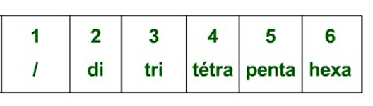
Nomenclature of alkanes
How to Name Branched Alkanes?
IUPAC Rule 3:
Number the carbon atoms in the longest chain, starting from the end closest to a substituent to give the lowest possible numbers to the branches.
IUPAC Rule 4:
Write the name of the alkane by listing all substituents in alphabetical order, followed by the name of the main chain. Use prefixes (di-, tri-, tetra-) if the same substituent appears more than once, but do not consider them for alphabetical ordering

Slide 16
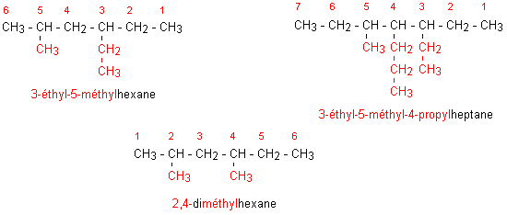
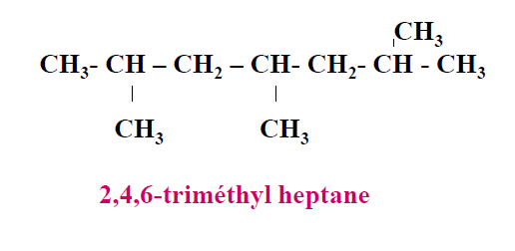

Slide 17
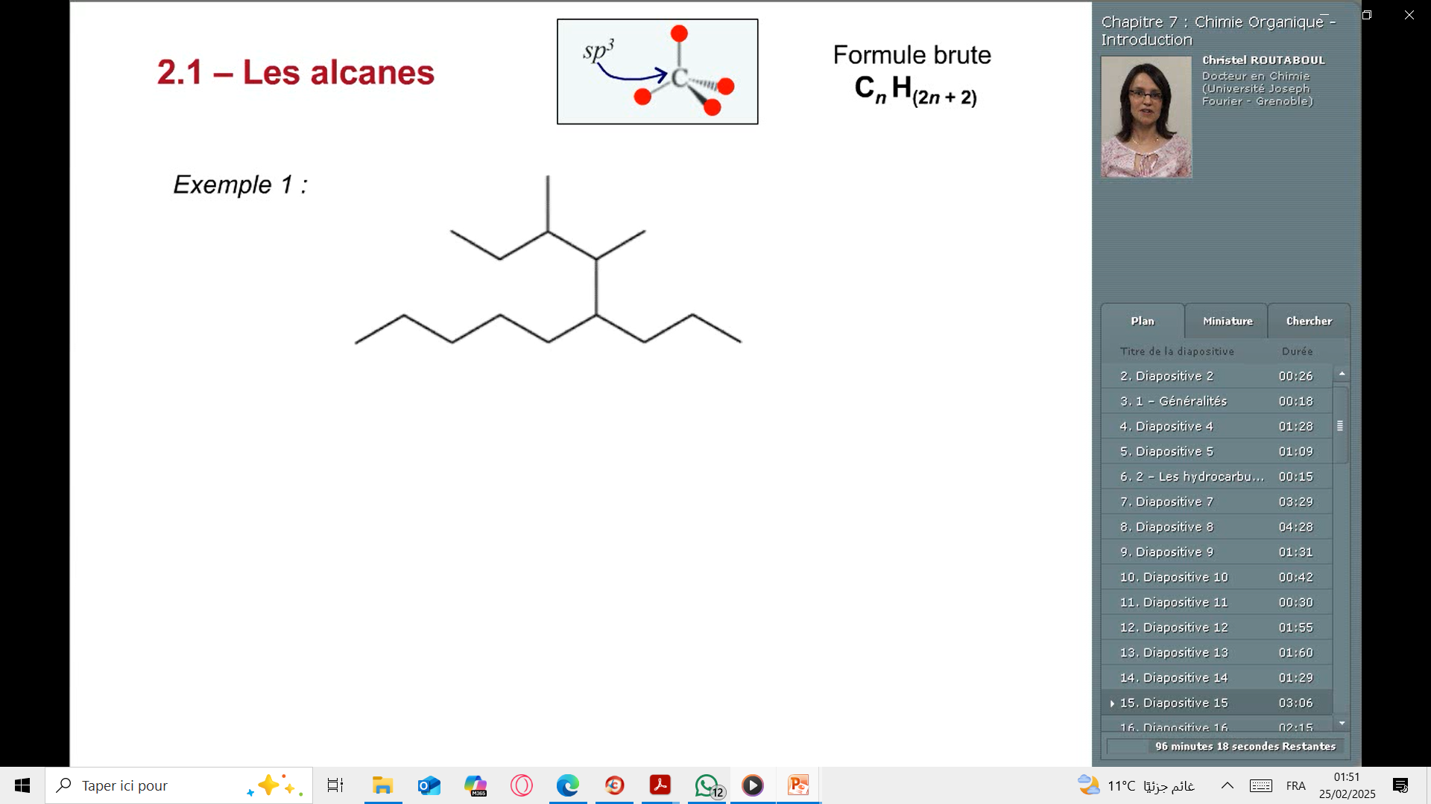
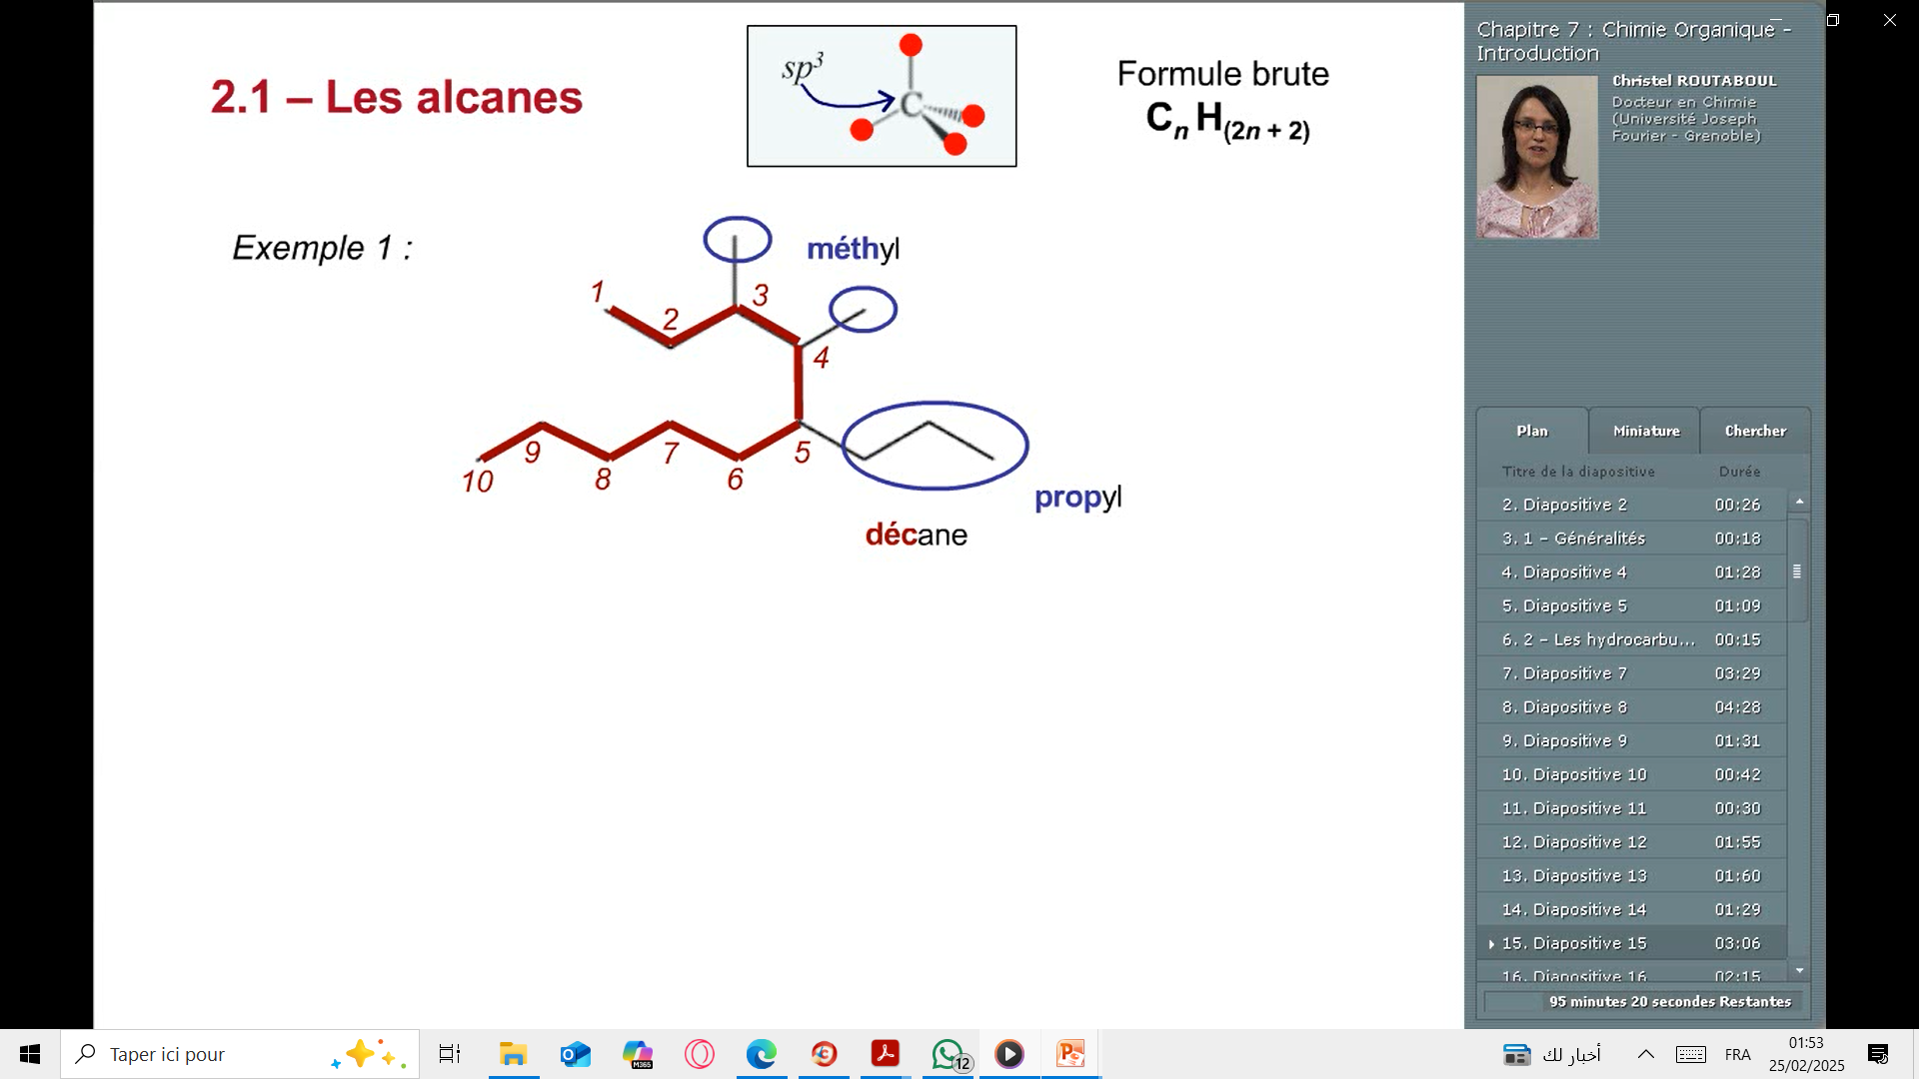
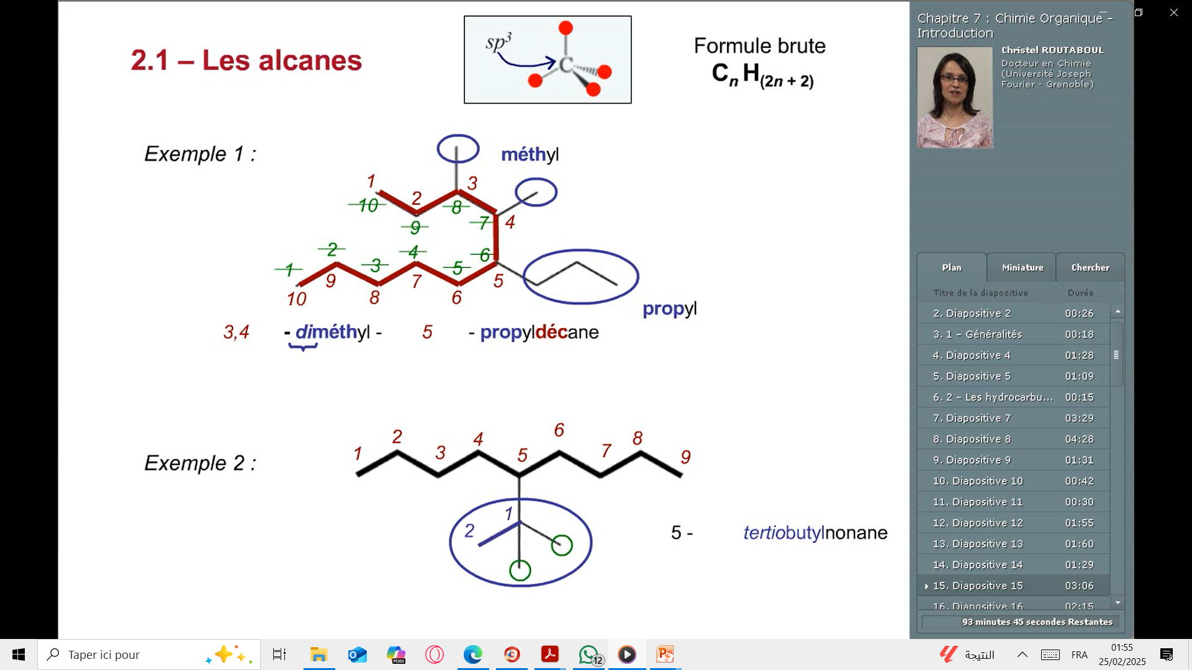
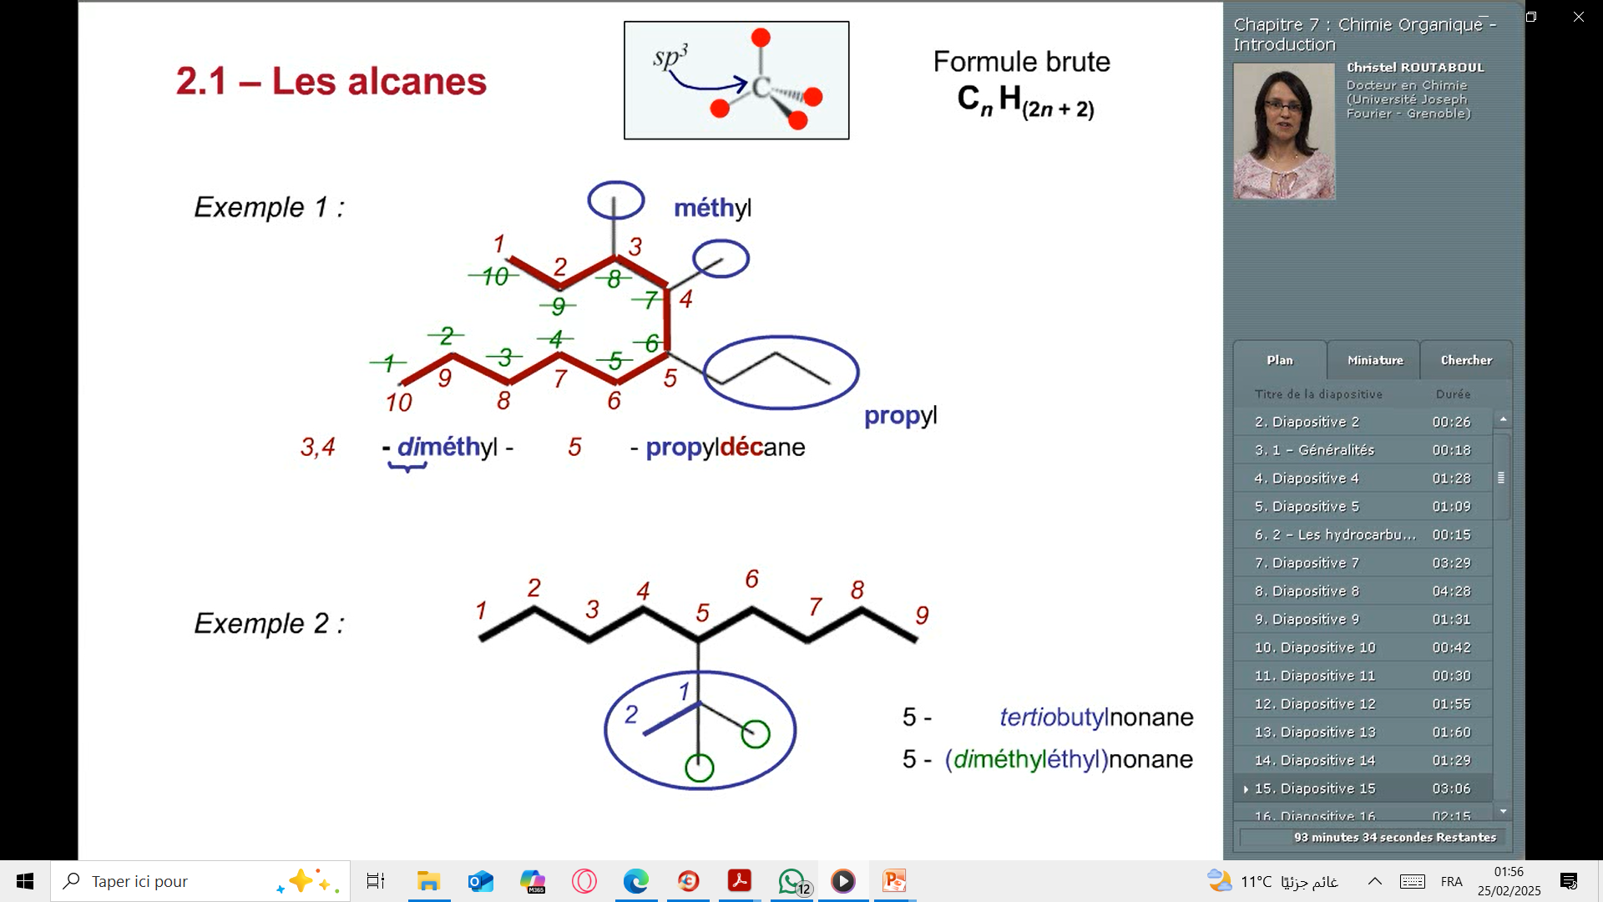
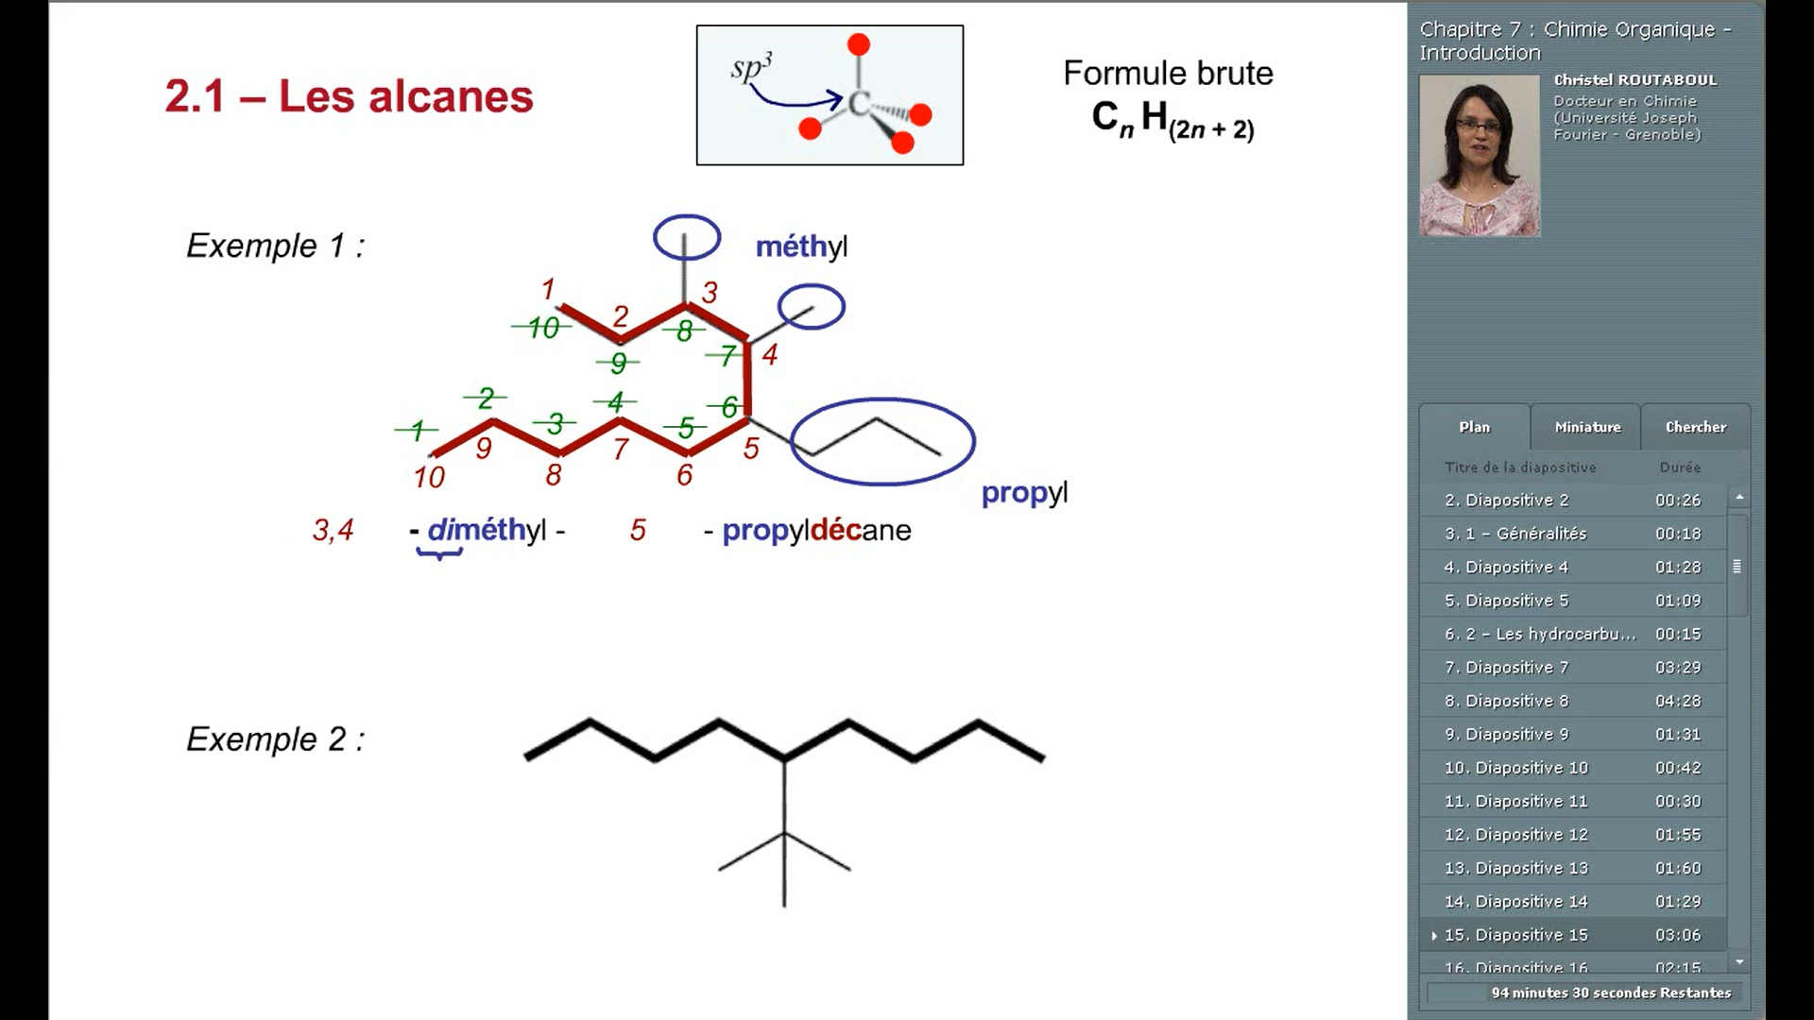
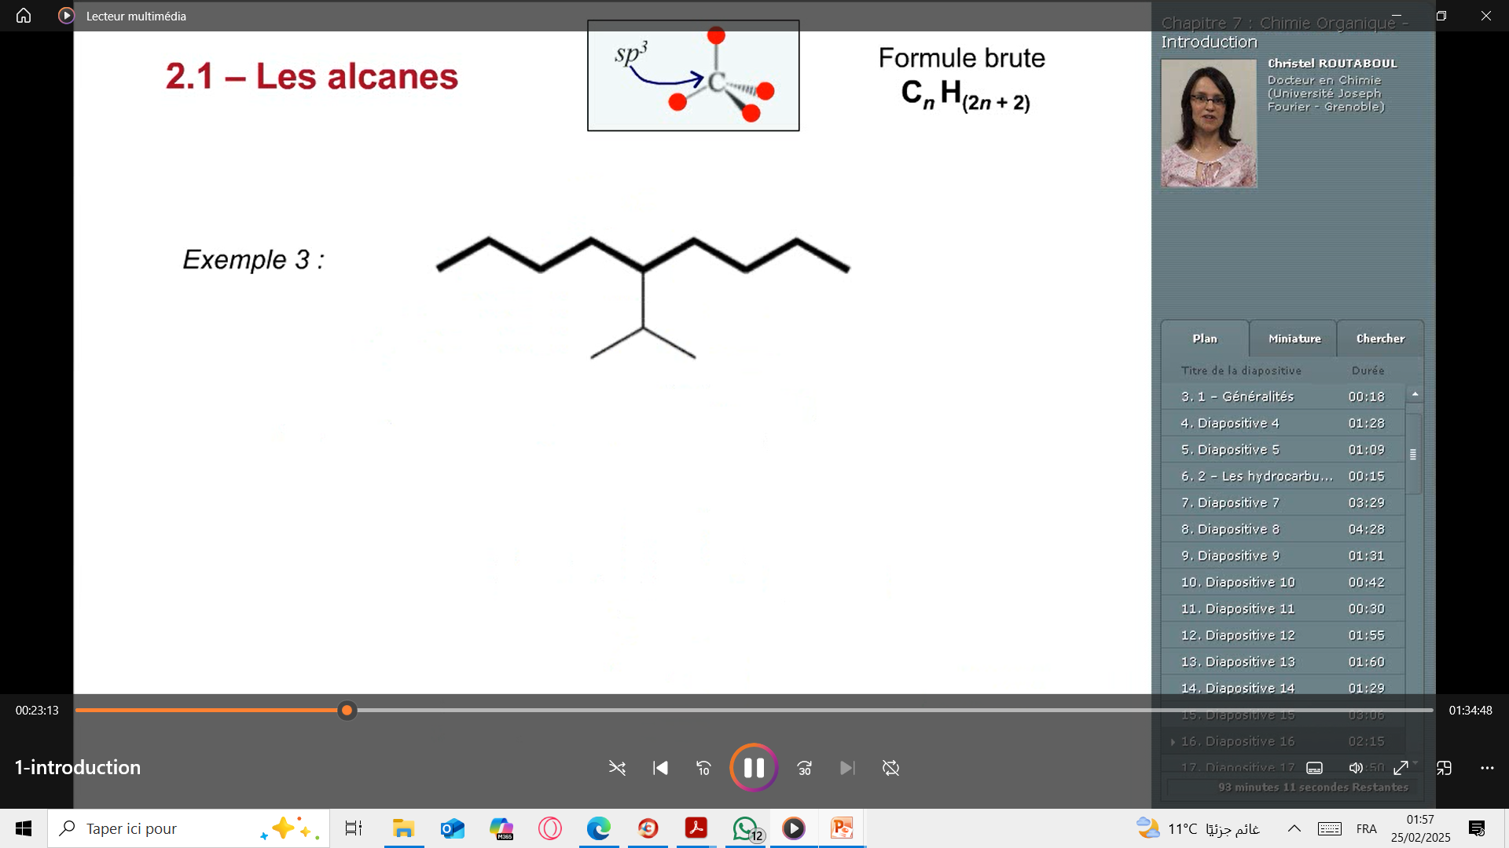
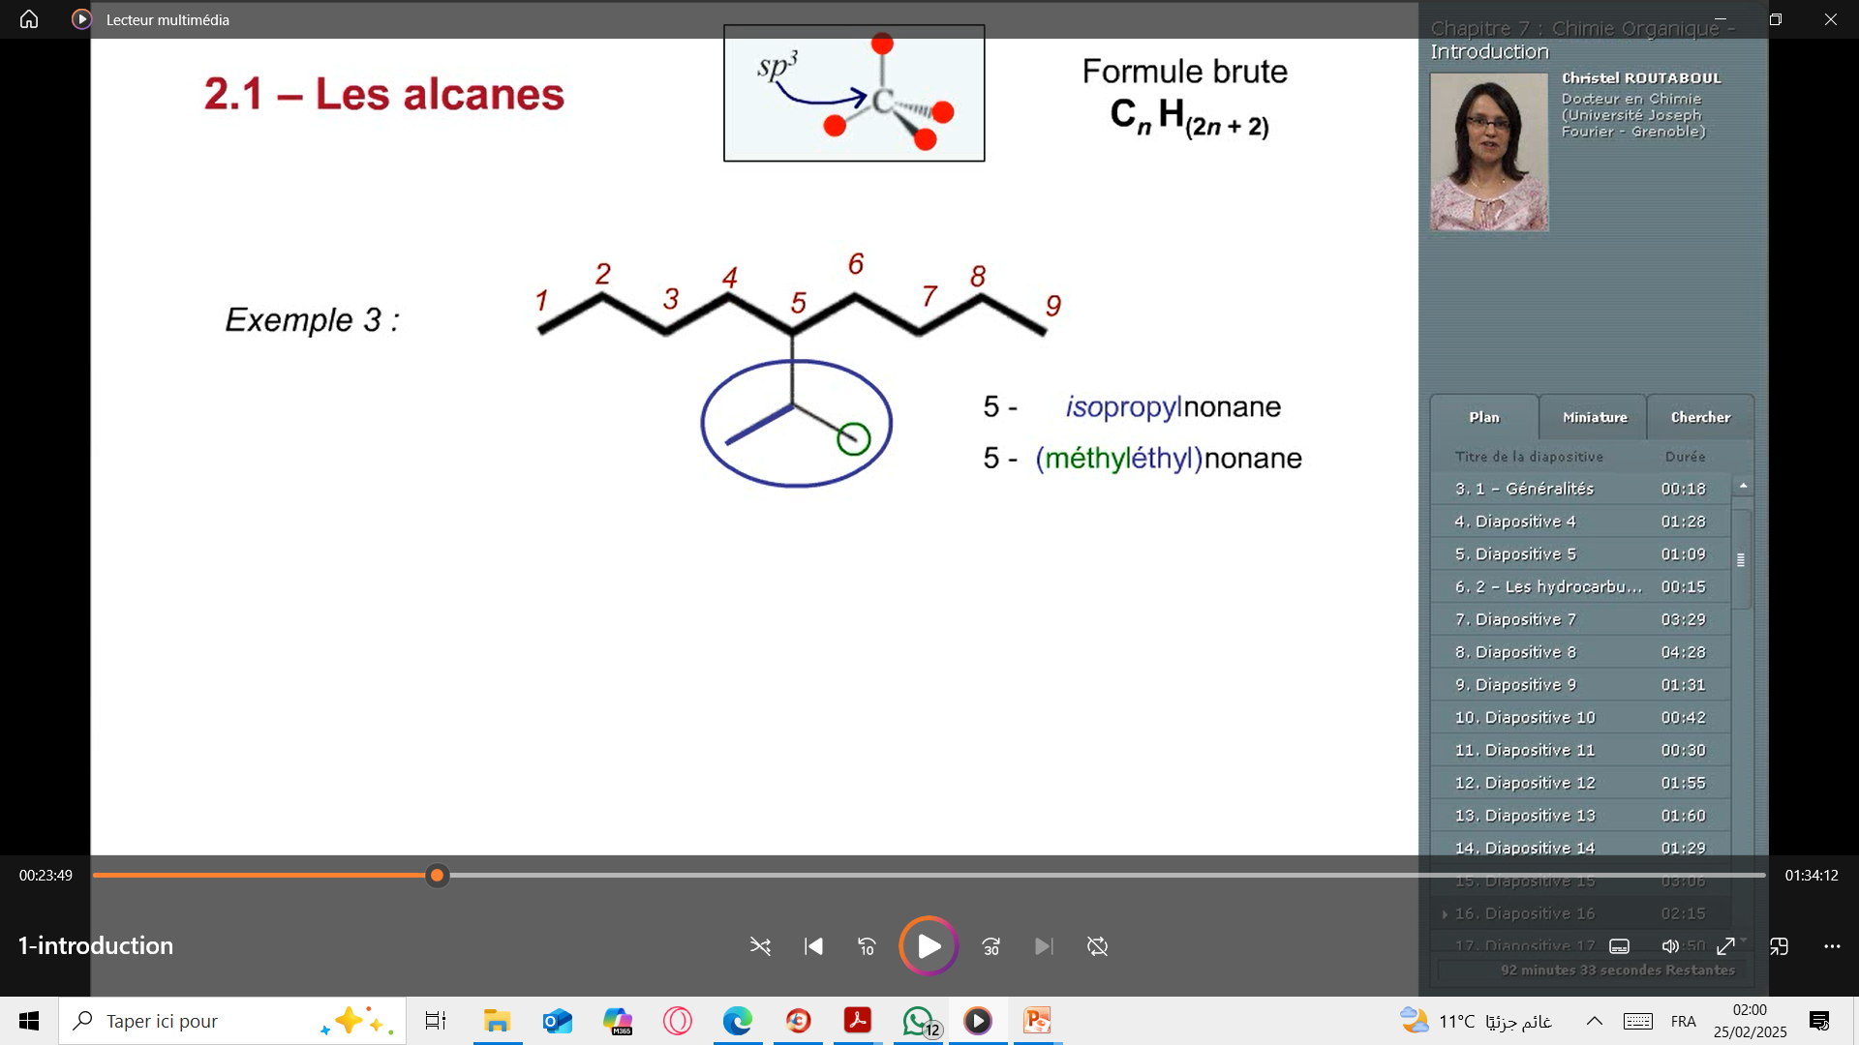
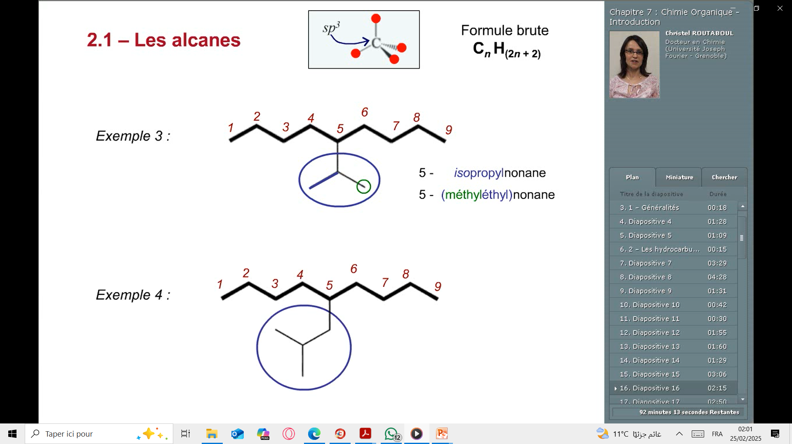
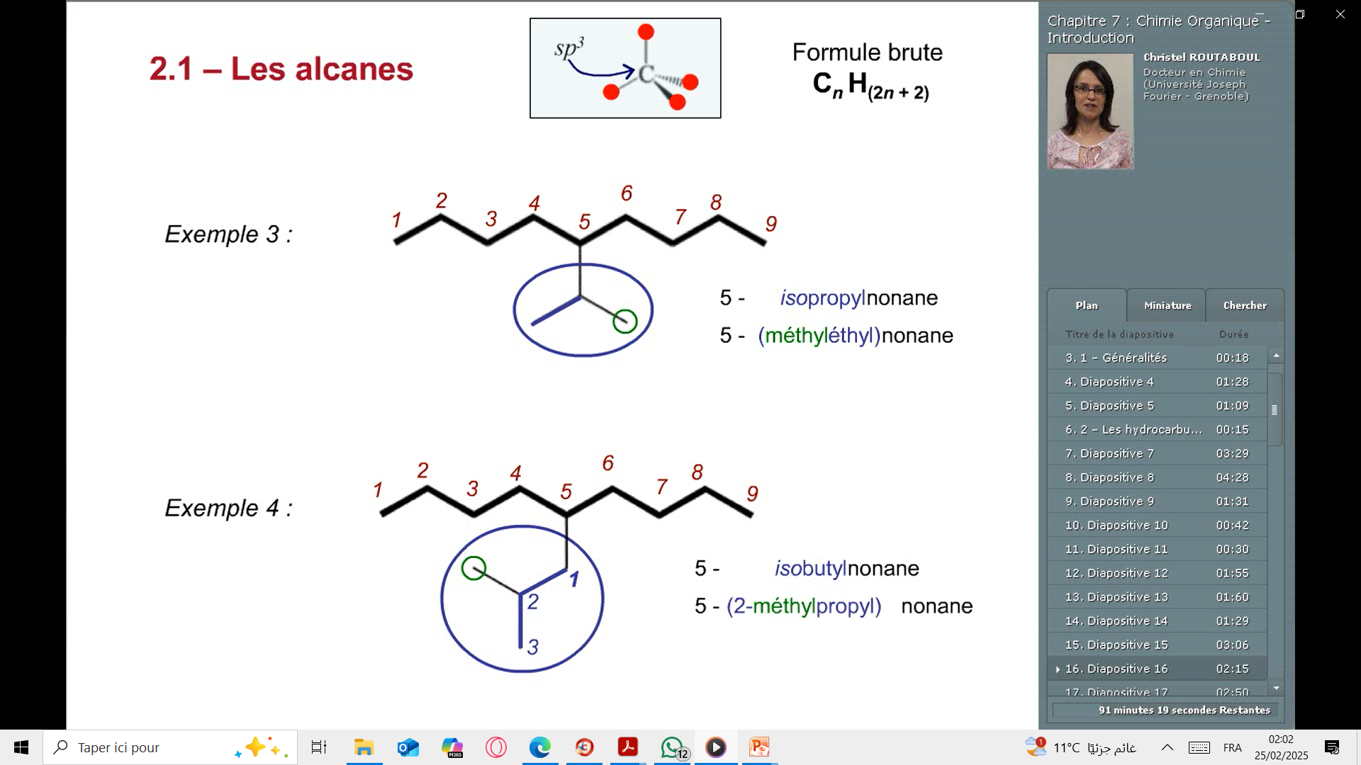

Slide 18
Nomenclature of alkenes
CₙH₂ₙ
General formula:
Alkenes are unsaturated hydrocarbons. The names of the first 10 linear alkenes are given in Table 3.
n | Nom | Formule
2 | Ethene | C₂H₄
3 | Propene | C₃H₆
4 | Butene | C₄H₈
5 | Pentene | C₅H₁₀
6 | Hexene | C₆H₁₂
7 | Heptene | C₇H₁₄
8 | Octene | C₈H₁₆
9 | Nonene | C₉H₁₈
10 | Decene | C₁₀H₂₀
The name of saturated hydrocarbons consists of :
prefix + suffix
Prefix: indicating the number of carbon atoms,
suffix : "-ene" (indicating an alkene).

Slide 19
Nomenclature of alkenes
How to Name Branched Alkenes?
The IUPAC naming rules for alkanes also apply to alkenes, with the "-ane" suffix replaced by "-ene". The position of the double bond in the main chain is indicated by a number.
Rule 1:
Identify the longest chain that contains the functional group, i.e., the C=C double bond.
Rule 2:
Indicate the position of the double bond in the main chain using a number, starting the numbering from the end closest to the double bond.

Slide 20
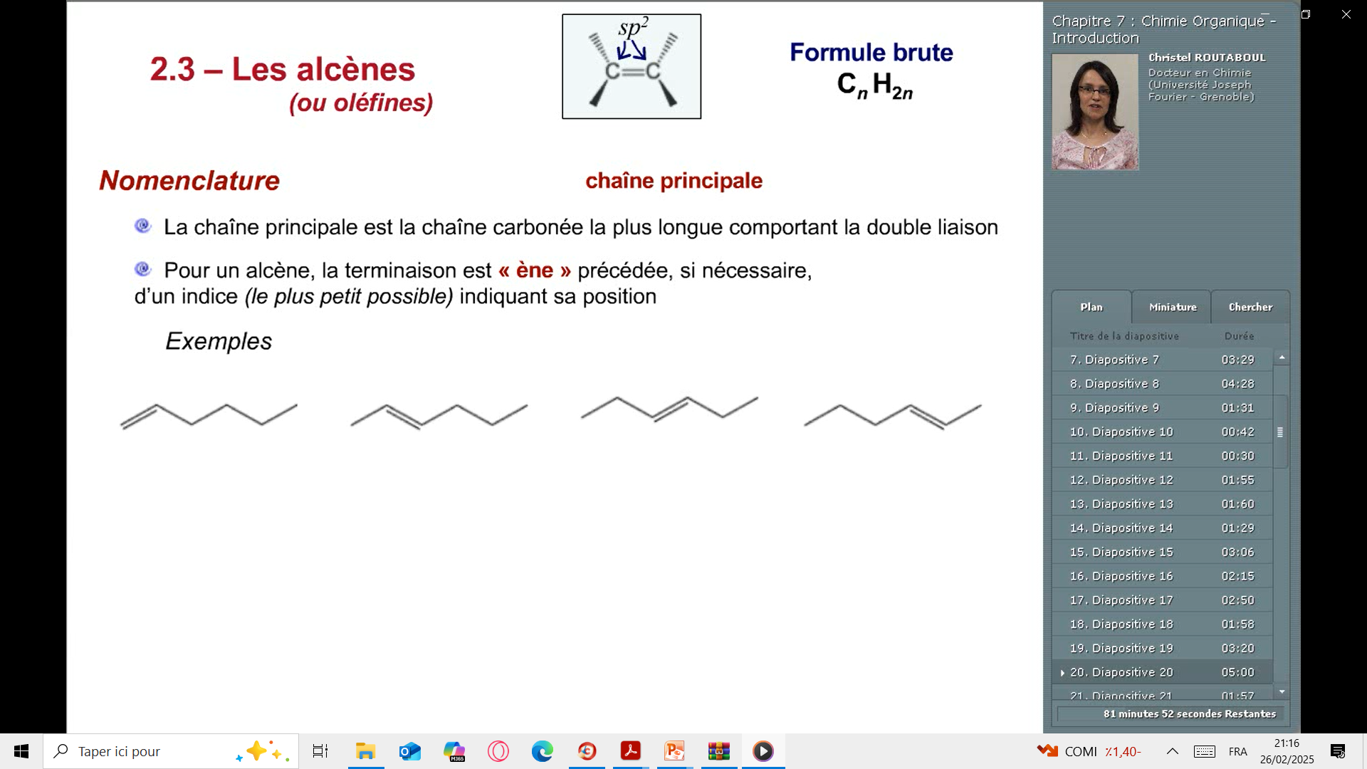
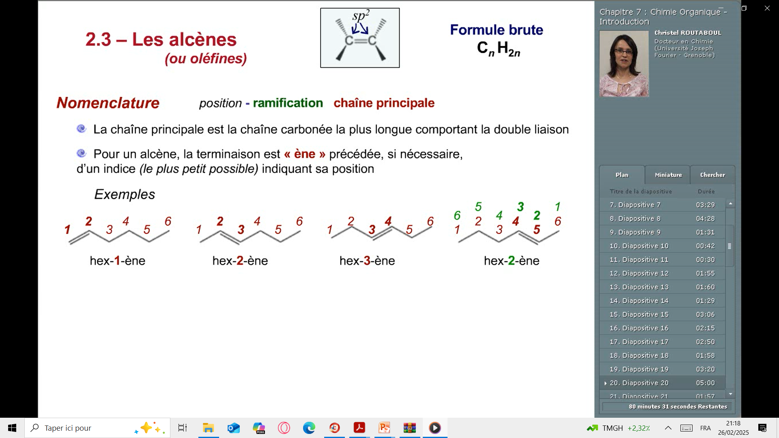
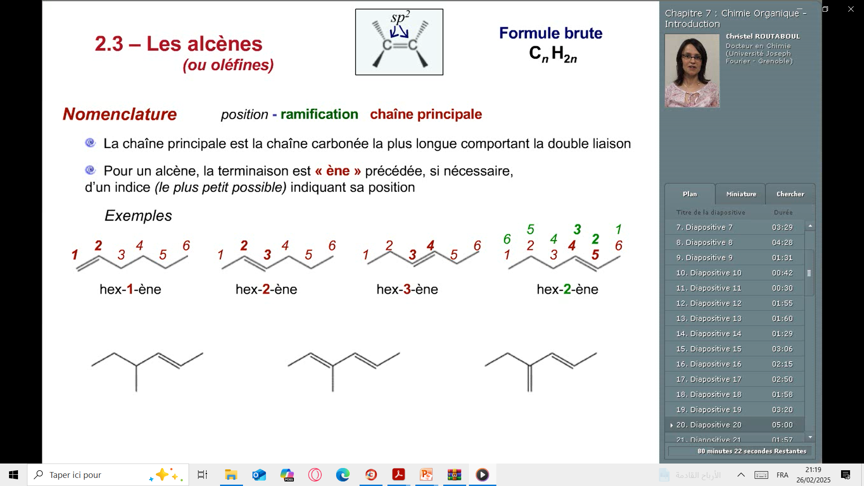
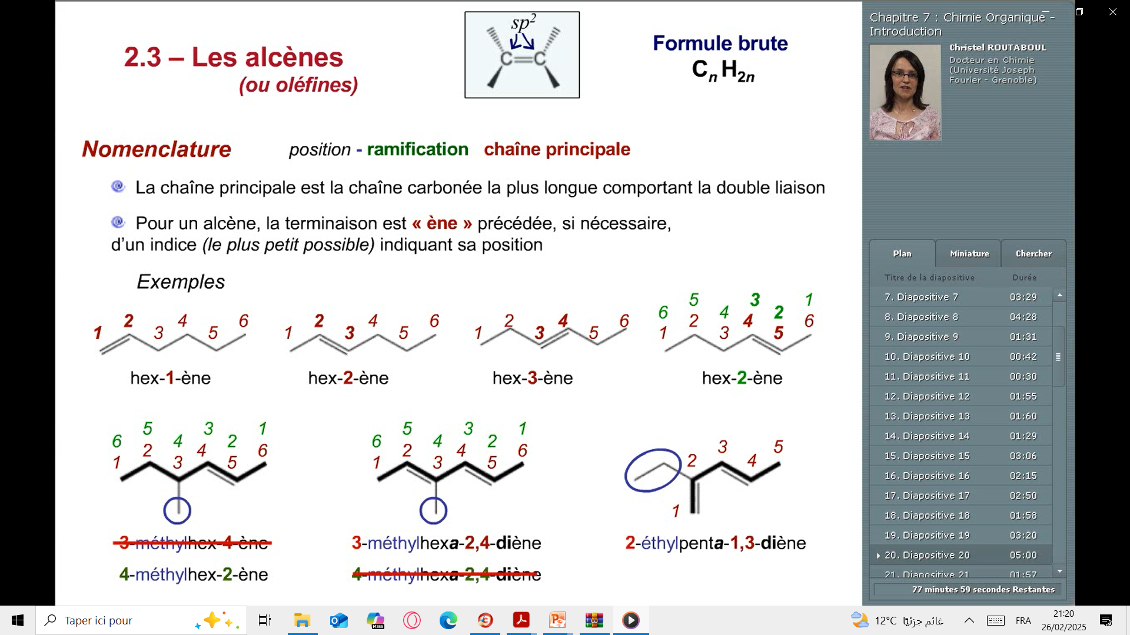

Slide 21
Nomenclature of alkynes
CₙH₂ₙ₋₂
General formula:
Alkynes are unsaturated hydrocarbons. The names of the first 10 linear alkynes are given in Table 4.
n | Nom | Formule
2 | Ethyne | C₂H₂
3 | Propyne | C₃H₄
4 | Butyne | C₄H₆
5 | Pentyne | C₅H₈
6 | Hexyne | C₆H₁₀
7 | Heptyne | C₇H₁₂
8 | Octyne | C₈H₁₄
9 | Nonyne | C₉H₁₆
10 | Decyne | C₁₀H₁₈
The name of saturated hydrocarbons consists of :
prefix + suffix
Prefix: indicating the number of carbon atoms,
suffix : "-yne" (indicating an alkene).

Slide 22
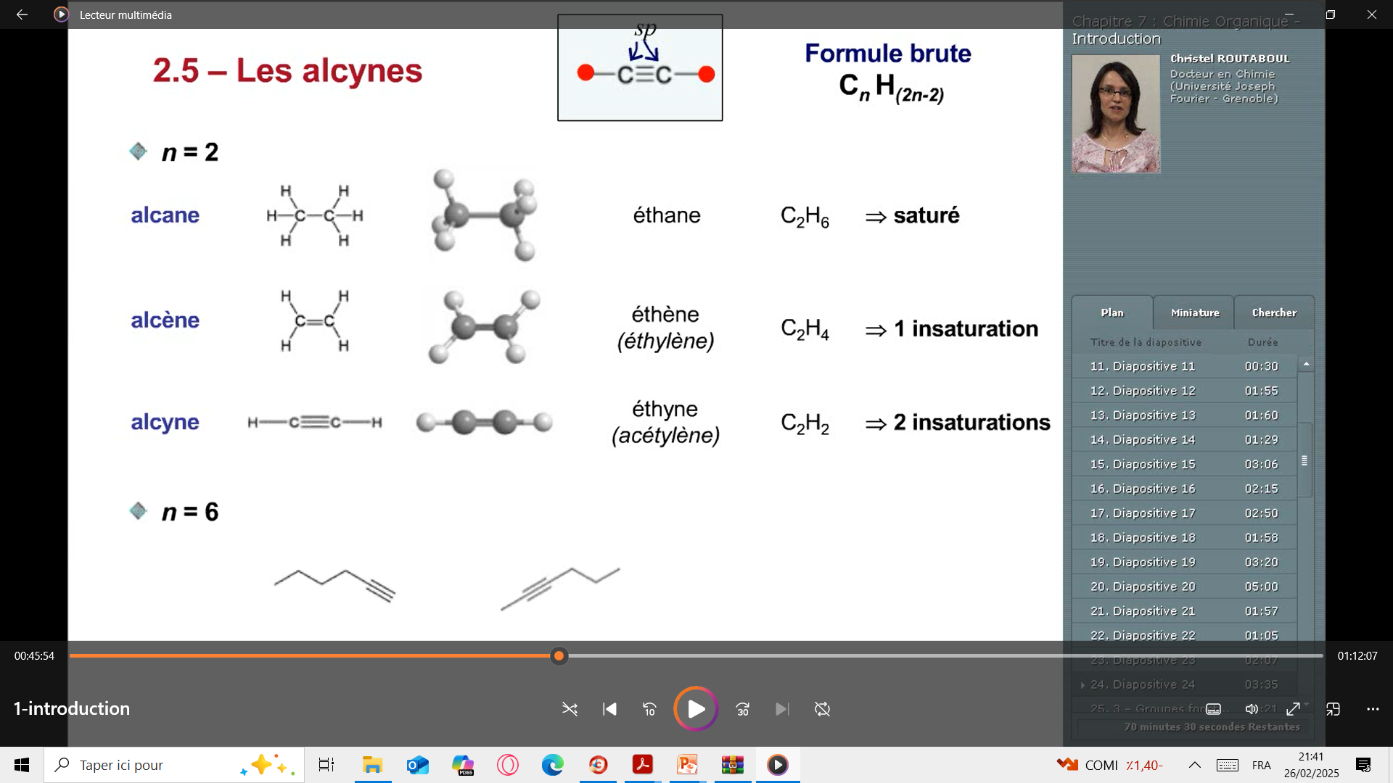
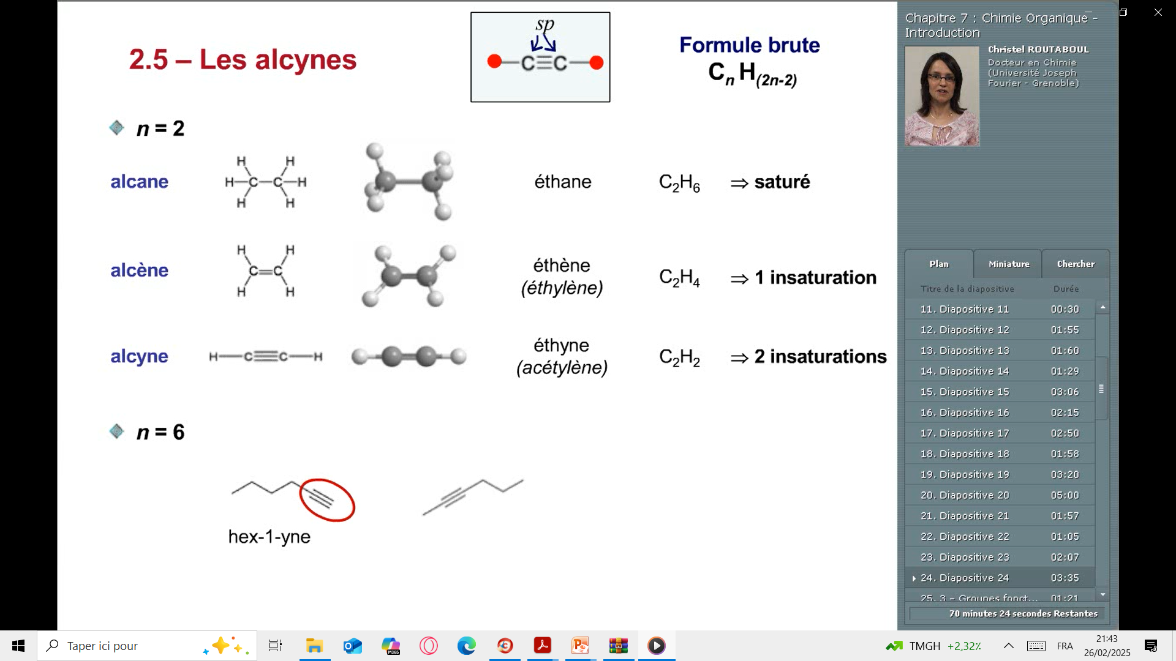
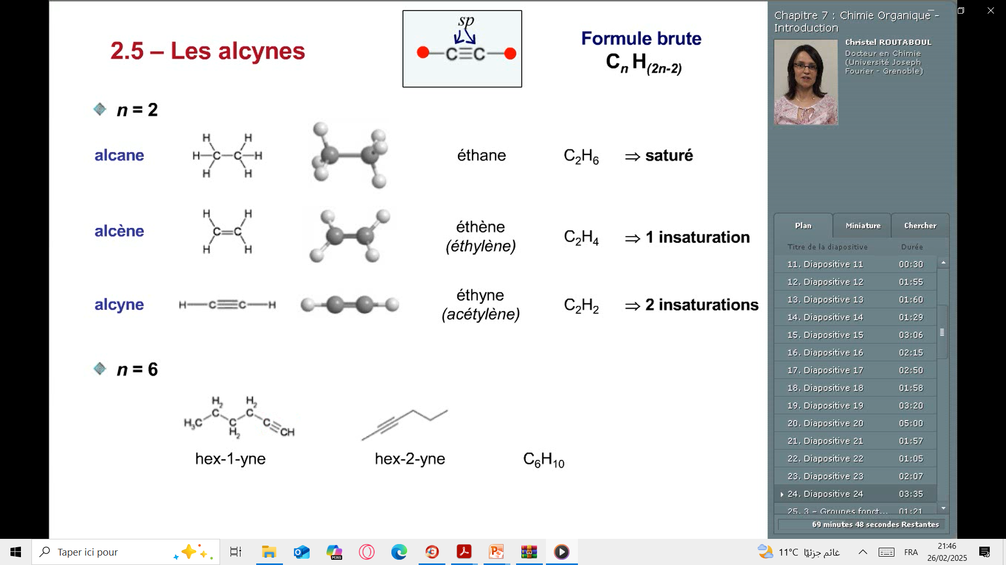

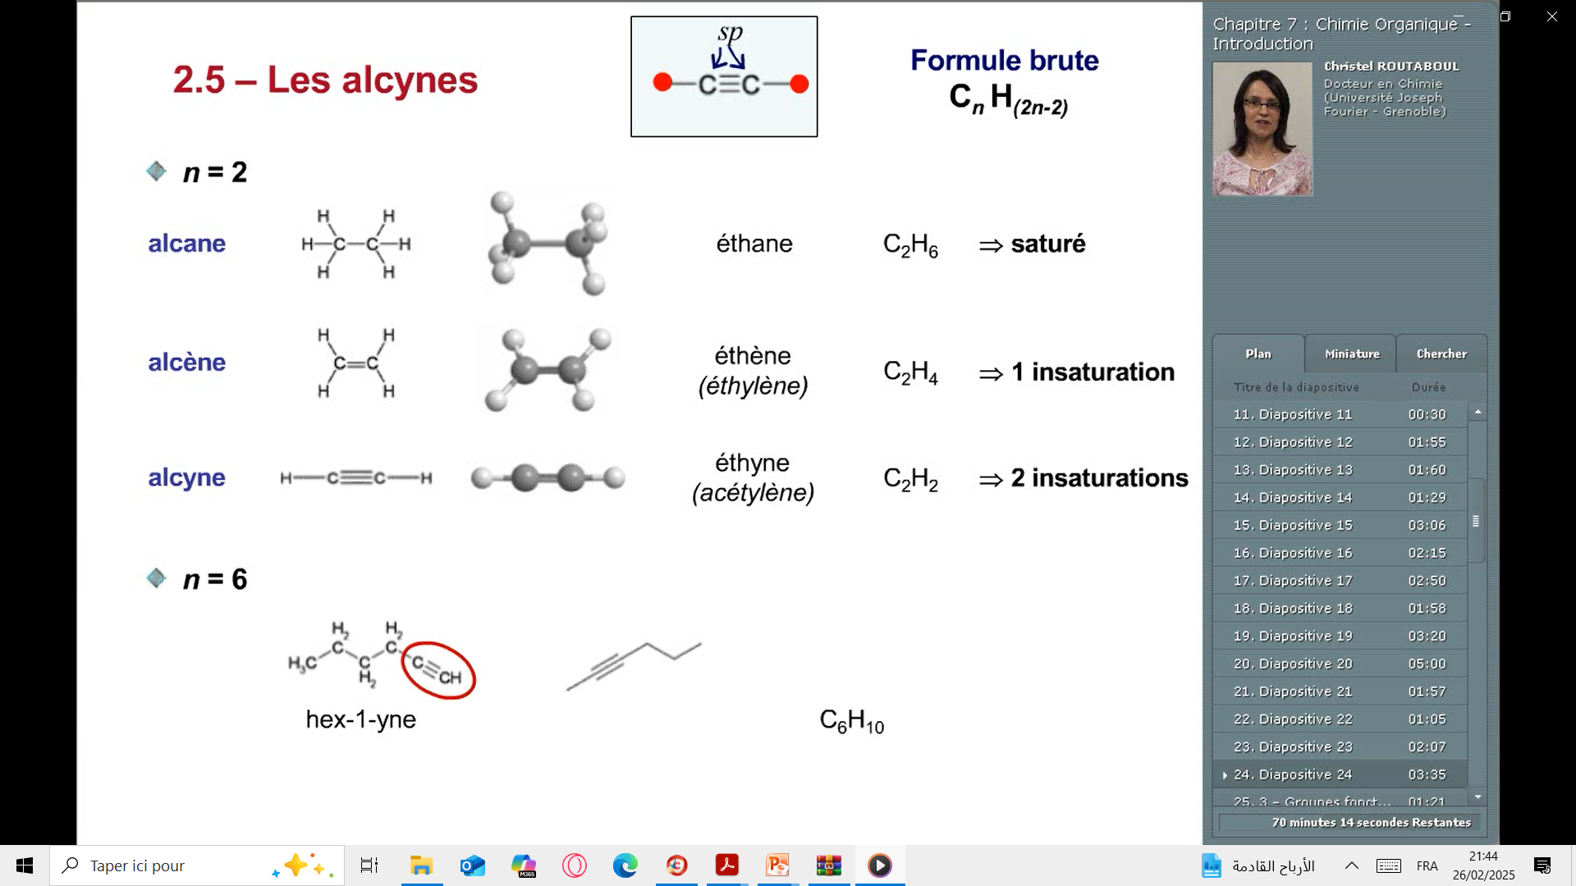
Nomenclature of alkynes
How to Name Branched Alkynes?
The IUPAC naming rules for alkanes also apply to alkynes, with the "-ane" suffix replaced by "-yne". The position of the triple bond in the main chain is indicated by a number.

Slide 23
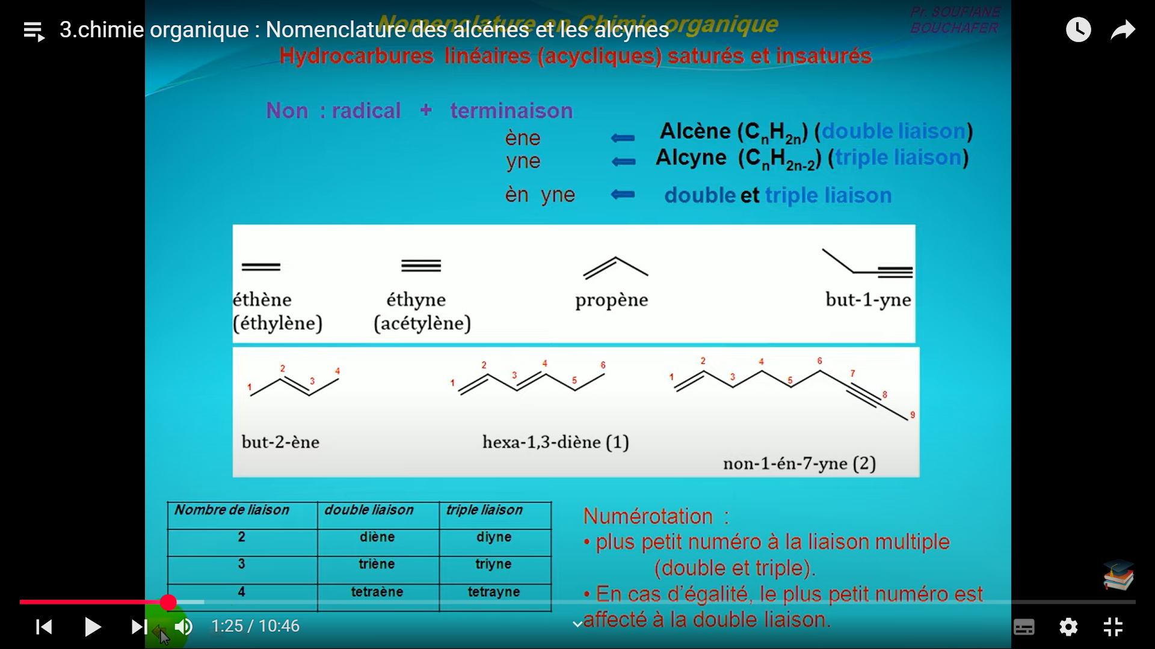
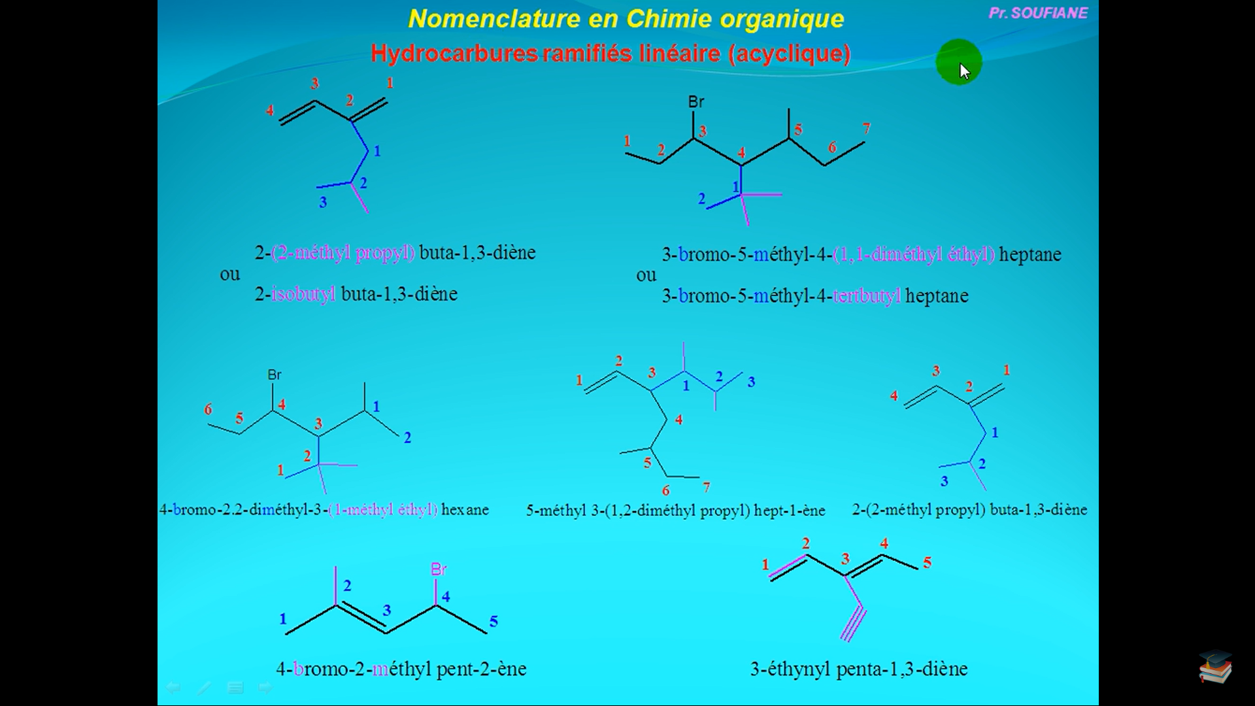
Notes:
PS: The double bond has priority for numbering, but the alkyne (-yne) remains the final suffix.

Slide 24
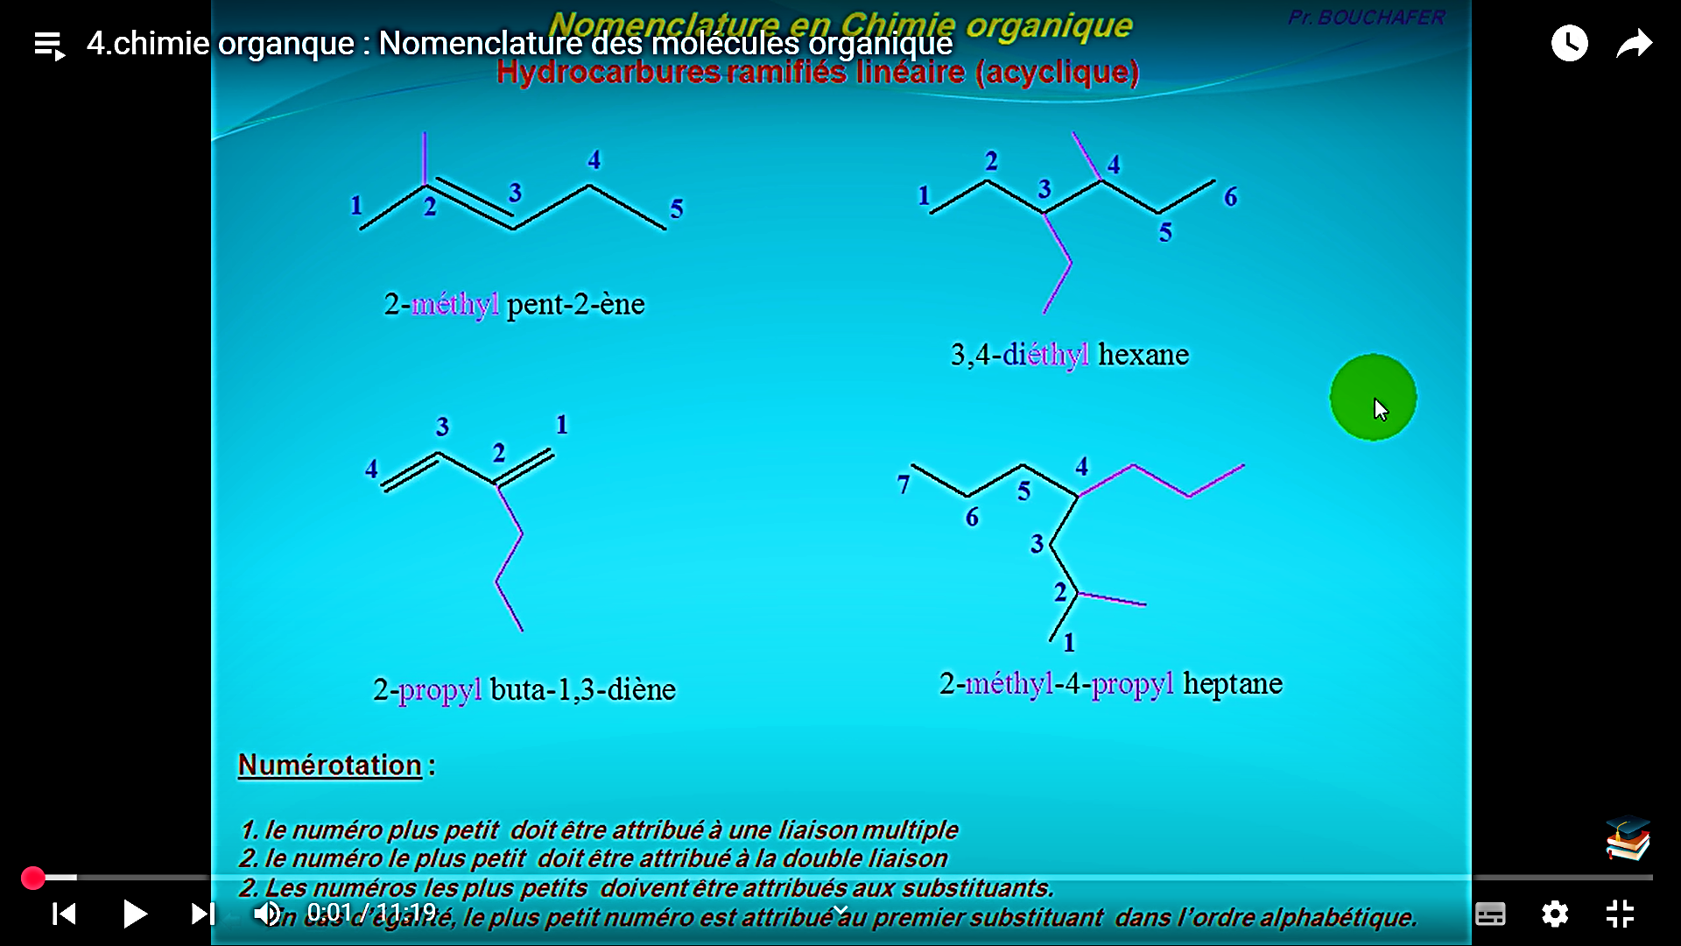

Slide 25
Functional groups
A functional group (or function) is a group of atoms that includes at least one heteroatom (an atom other than C or H, such as O, N, S, P, etc.).
Functional groups, along with unsaturations, are the primary sites of reactivity in an organic molecule. The carbon to which the heteroatom is attached is called the "functional carbon ".
If the molecule contains only one functional group, its name is obtained by adding a suffix indicating the nature of the function after the name of the corresponding hydrocarbon.
If a molecule has multiple functional groups, one of them must be placed as a suffix (except for alkyl halides, which are never considered priority functions), while all others are written as prefixes.

Slide 26
Functional groups
Determination of the Name of a Molecule with Multiple Functional Groups:
The priority functional group is designated by a suffix, while the other functional groups are indicated as prefixes, preceded by position numbers.
The chain suffixes ("ane," "ene," "yne") are placed before the suffix of the priority functional group.
The main chain is the longest chain that contains the functional carbon.
The numbering direction of the main chain is chosen so that the functional carbon is assigned the lowest possible number.
Prefix of the non-priority function | Main chain, | Suffix (-ane, -ene, or -yne) | Suffix of the priority function

Slide 27
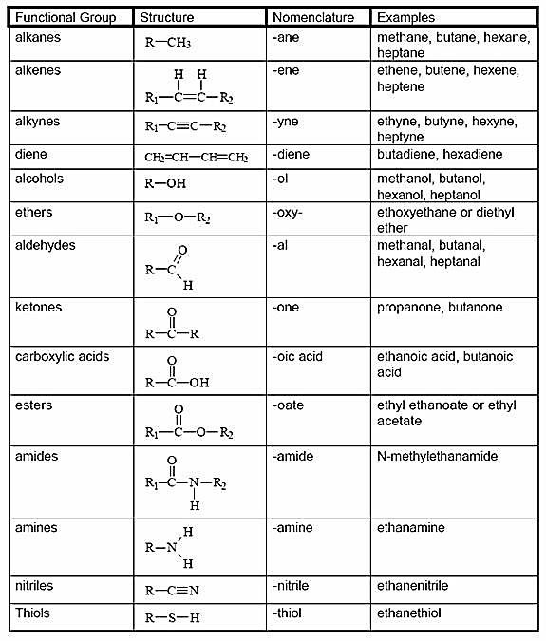
Functional groups

Slide 28
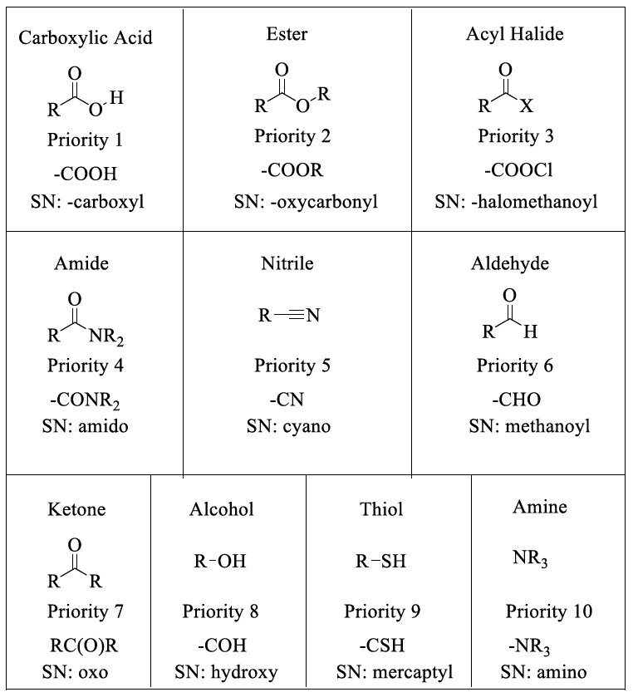
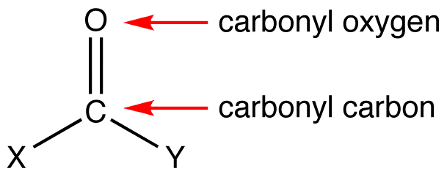
Functional groups
Carbonyle groups

Slide 29
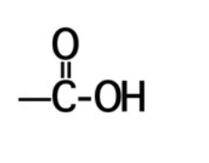
1- carboxylic acid
Functional groups
Denomination: Alkanoic // Symbol: RCOOH
Structure of a carboxylic acid
Carboxylic Acids carboxyl group The functional group of a carboxylic acid is a carboxyl group, which can be represented in any one of three ways.
Structure | IUPAC Name | Common Name | Natural Source
HCOOH | Methanoic acid | Formic acid | Ants
CH₃COOH | Ethanoic acid | Acetic acid | Vinegar
CH₃CH₂COOH | Propanoic acid | Propionic acid | Dairy products
CH₃CH₂CH²COOH | Butanoic acid | Butyric acid | Butter
CH³(CH₂)₃COOH | Pentanoic acid | Valeric acid | Valerian root
CH₃(CH₂)₄COOH | Hexanoic acid | Caproic acid | Goat odor

Slide 30
Functional groups
How to Name carboxylic acid ?
Nomenclature IUPAC names:
For an acyclic carboxylic acid, take the longest carbon chain that contains the carboxyl group as the parent alkane.
Drop the final -e from the name of the parent alkane and replace it by -oic acid.
Number the chain beginning with the carbon of the carboxyl group.
Because the carboxyl carbon is understood to be carbon 1, there is no need to give it a number.

Slide 31
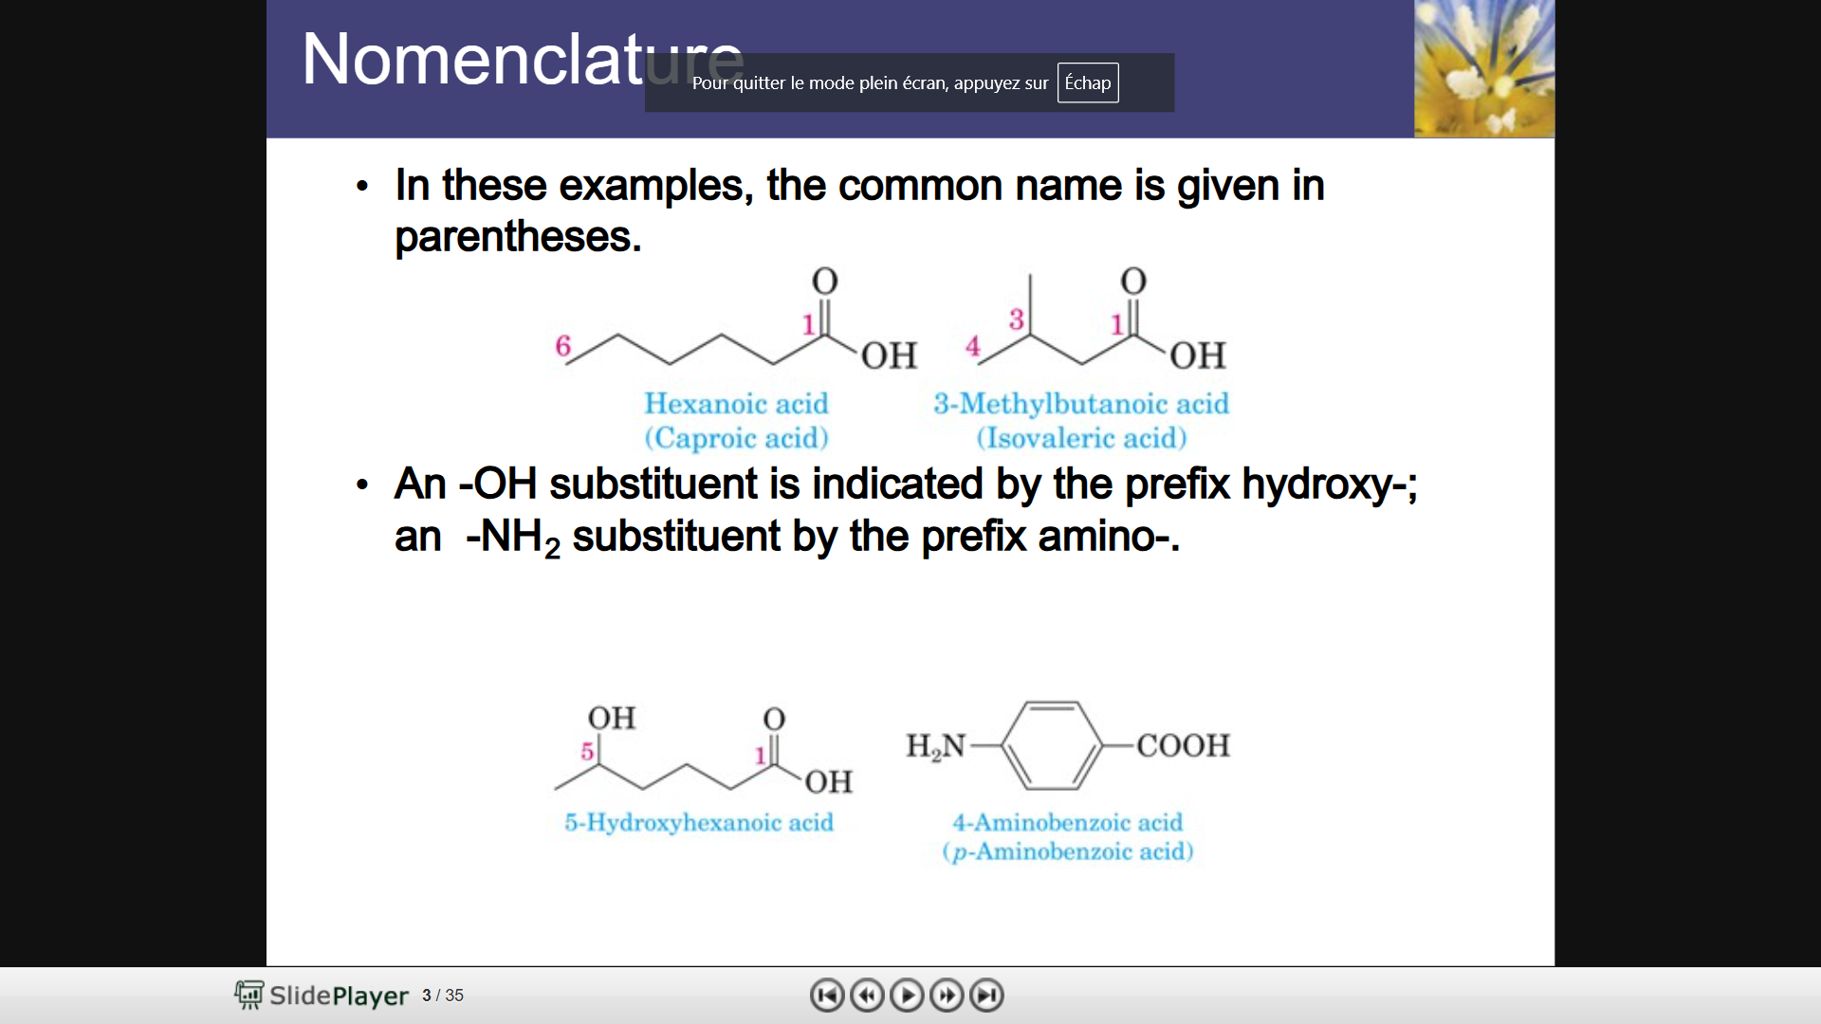
Functional groups
Hydroxy-

Slide 32
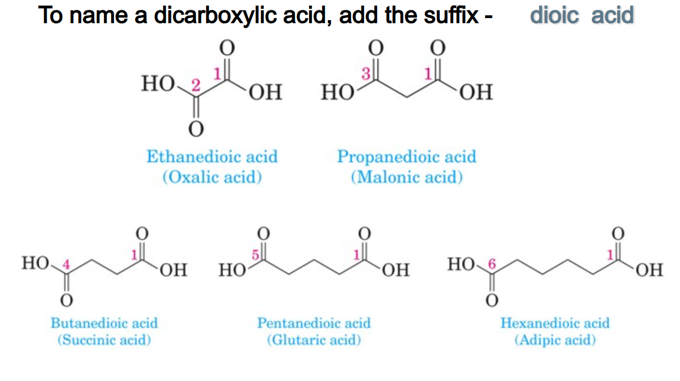
Functional groups
Dicarboxylic acids are named as dioic acids. Their common names reflect their natural origins.
Structure | IUPAC Name | Common Name
HOOC-COOH | Ethanedioic acid | Oxalic acid
HOOC-CH₂-COOH | Propanedioic acid | Malonic acid
HOOC-(CH2)₂-COOH | Butanedioic acid | Succinic acid
HOOC-(CH₂)₃-COOH | Pentanedioic acid | Glutaric acid
HOOC-(CH₂)₄-COOH | Hexanedioic acid | Adipic acid

Slide 33
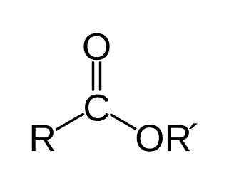
2- Esters
Functional groups
Denomination: Alkyl (from alcohol) + (Carboxylate from acid)
Structure of a Esters
Esters are organic compounds derived from carboxylic acids, where the hydroxyl group (-OH) is replaced by an alkoxy group (-OR).
Their general formula is R-COO-R'.
Esters are derived from carboxylic acids and (usually) alcohol. While carboxylic acid has the -COOH group, the hydrogen is replaced by a hydrocarbon in an ester.

Slide 34
2- Esters
Functional groups
How to Name carboxylic acid ?
IUPAC Naming Rules for Esters
1- Identify the parent carboxylic acid:
Replace the "-oic acid" suffix with "-oate".
Example: ethanoic acid (CH₃COOH) → ethanoate.
2- Identify the alkyl group (-R') attached to the oxygen:
Name this group as a separate word before the carboxylate name.
Example: methyl (CH₃), ethyl (C₂H₅), propyl (C₃H₇), etc.

Slide 35
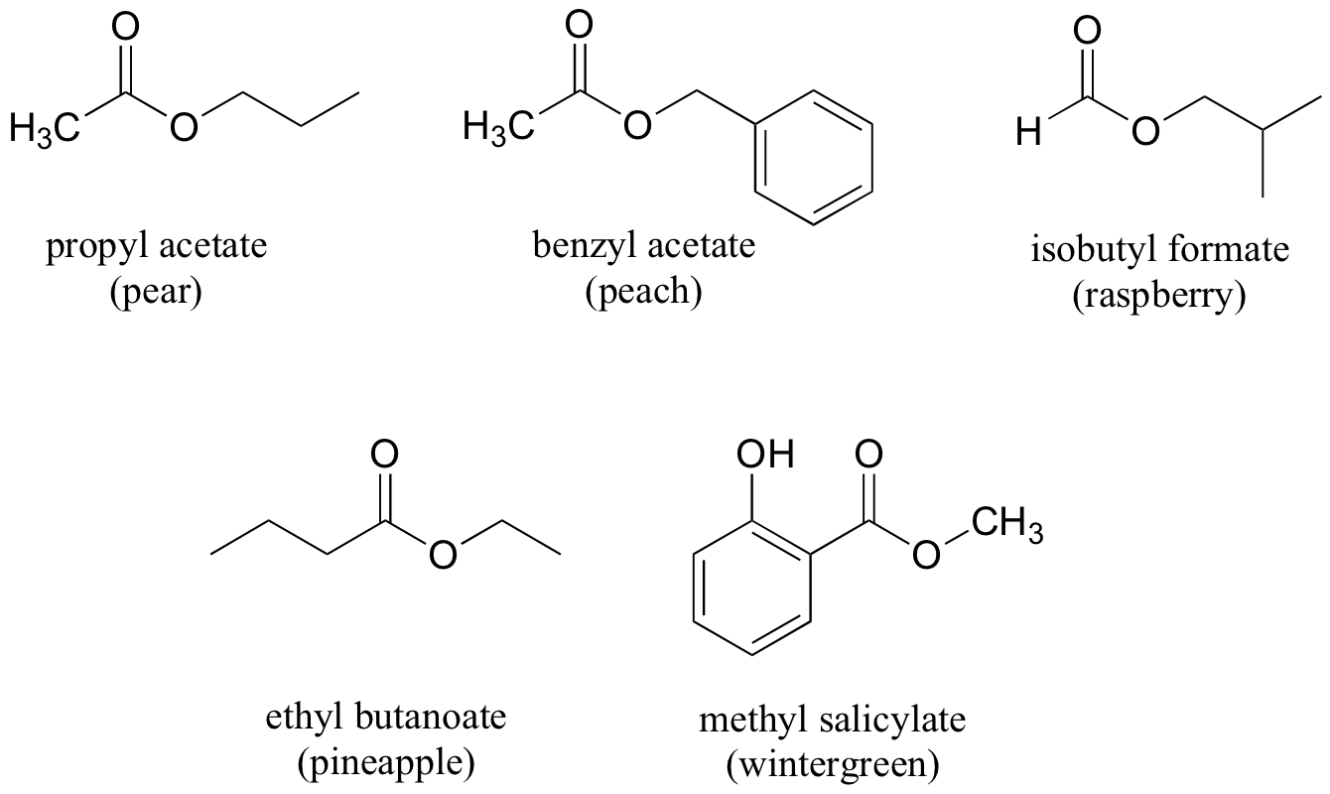
2- Esters
Functional groups
(Alkyl from alcohol) + (Carboxylate from acid)
Structure | IUPAC Name | Common Name
CH₃COOCH₃ | Methyl ethanoate | Methyl acetate
CH₃COOC₂H₅ | Ethyl ethanoate | Ethyl acetate
C₂H₅COOCH₃ | Methyl propanoate | Methyl propionate
C₃H₇COOC₂H₅ | Ethyl butanoate | Ethyl butyrate
C₄H₉COOCH₃ | Methyl pentanoate | Methyl valerate
ethanoate
methanoate

Slide 36
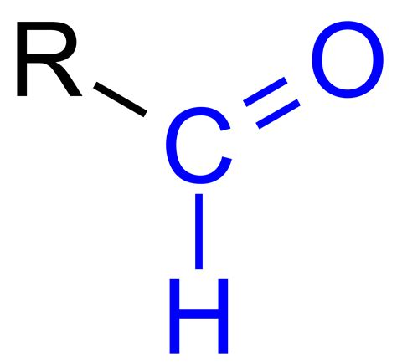
3- Aldehydes
Functional groups
Aldehydes are organic compounds containing the carbonyl functional group (-CHO) at the end of a carbon chain.
Their general formula : R-CHO.
How to Name carboxylic acid ?
IUPAC Naming Rules for Aldehydes
Identify the longest carbon chain containing the -CHO group.
Replace the "-e" of the corresponding alkane name with "-al".
Example: Methane (methane) → methanal.
The -CHO group is always at position 1, so numbering is not needed.
If other substituents are present, numbering starts from the aldehyde carbon (C-1).

Slide 37
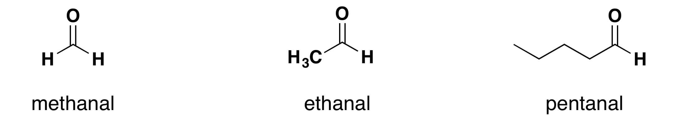
3- Aldehydes
Functional groups
Examples of Aldehyde Names:
Structure | IUPAC Name | Common Name
HCHO | Methanal | Formaldehyde
CH₃CHO | Ethanal | Acetaldehyde
CH₃CH₂CHO | Propanal | Propionaldehyde
CH₃(CH₂)₂CHO | Butanal | Butyraldehyde
CH₃(CH₂)₃CHO | Pentanal | Valeraldehyde

Slide 38
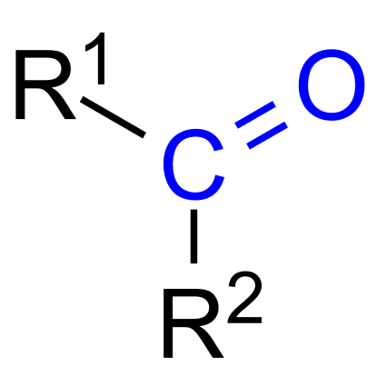
4- Ketones
Functional groups
Ketones are organic compounds containing the carbonyl functional group (-CO-) located within a carbon chain (not at the end).
Their general formula : R-CO-R'
How to Name a Ketones?
IUPAC Naming Rules for ketones
Identify the longest carbon chain containing the C=O (carbonyl) group.
Replace the "-e" of the corresponding alkane name with "-one".
Example: Propane (propane) → propanone.
Number the chain so that the carbonyl gets the lowest possible number.
If there are substituents, name and number them accordingly.

Slide 39
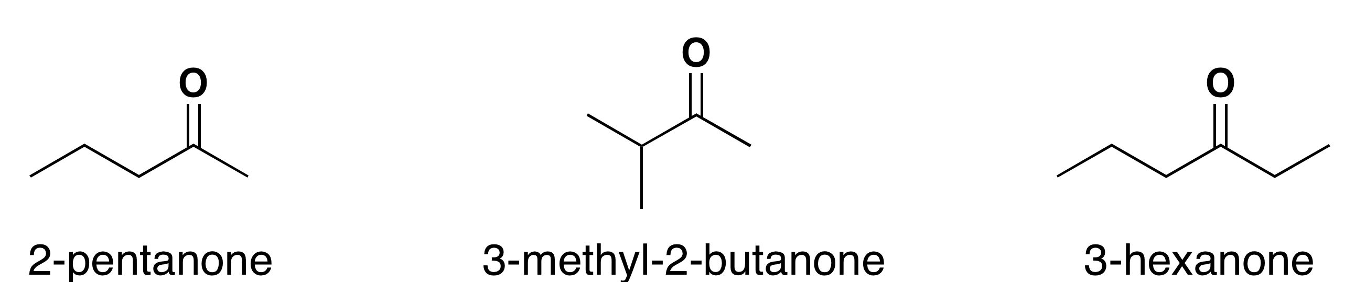
4- Ketones
Functional groups
Examples of ketones Names:
Structure | IUPAC Name | Common Name
CH₃COCH₃ | Propanone | Acetone
CH₃COCH₂CH₃ | Butan-2-one | Methyl ethyl ketone
CH₃COCH₂CH₂CH₃ | Pentan-2-one | Methyl propyl ketone
CH₃CH₂COCH₂CH₃ | Pentan-3-one | Diethyl ketone
CH₃COCH₂CH₂CH₂CH₃ | Hexan-2-one | Methyl butyl ketone

Slide 40
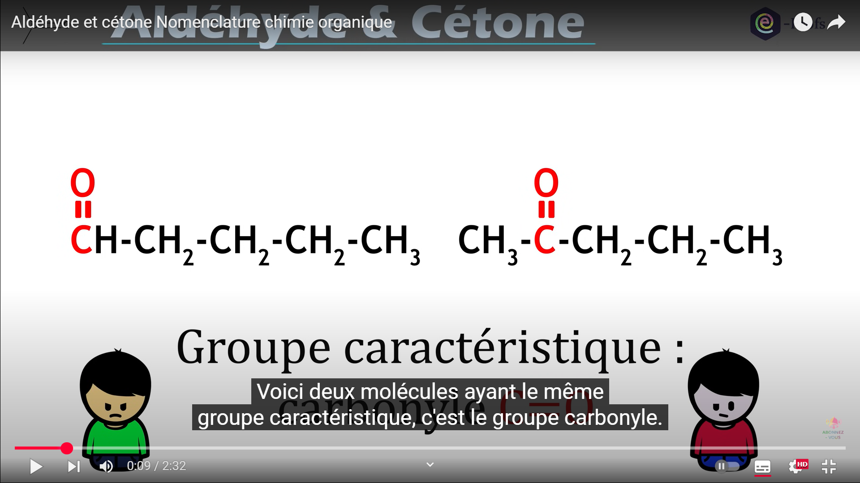
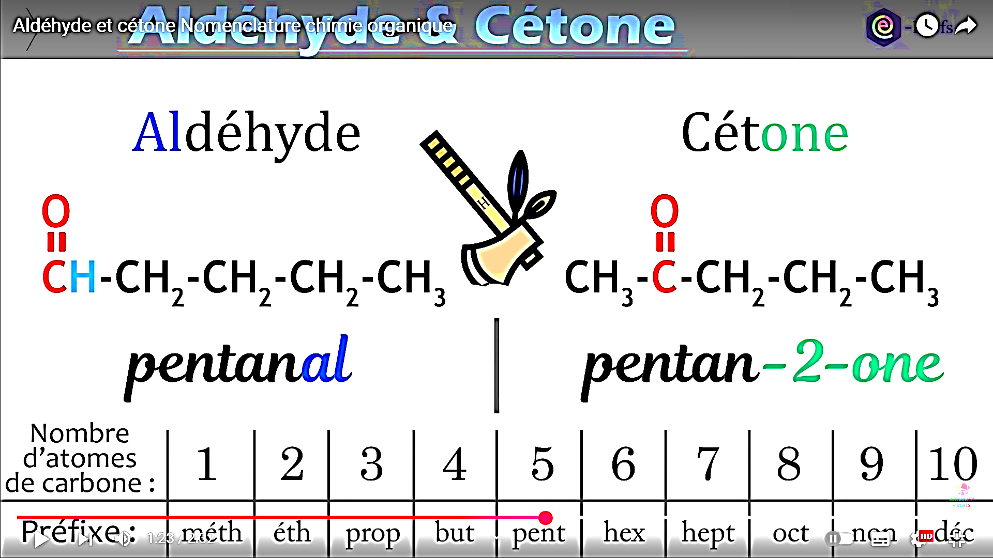
4- Ketones
Functional groups
Feature | Aldehydes (-CHO) | Ketones (-CO- within a chain)
Functional Group | -CHO (carbonyl at the end of the chain) | -CO- (carbonyl in the middle of the chain)
General Formula | R-CHO | R-CO-R'
Position of the Carbonyl | Always at the end of the carbon chain | Always within the carbon chain
Suffix (IUPAC Name) | "-al" (e.g., methanal, ethanal) | "-one" (e.g., propanone, butanone)
Aldehyde
Ketone

Slide 41
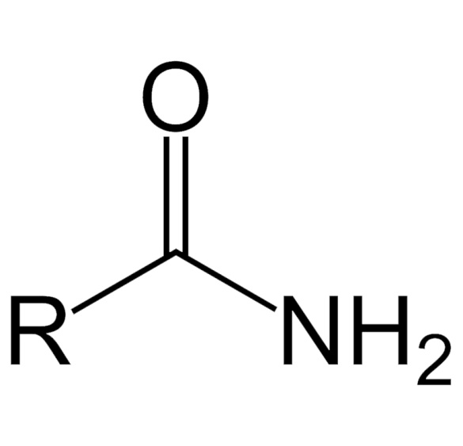
5- Amides
Functional groups
Amides are organic compounds containing the -CONH₂ functional group.
Their general formula : R-CONH₂
How to Name an Amides ?
IUPAC Naming Rules for Amides
Identify the longest carbon chain containing the amide (-CONH₂) group.
Replace the "-oic acid" of the corresponding carboxylic acid name with "-amide".
Example: Ethanoic acid (ethanoic acid) → ethanamide.
The amide group is always at position 1, so numbering is not needed.
If there are alkyl groups attached to the nitrogen (N-substituted amides), they are named as "N-" prefixes.

Slide 42
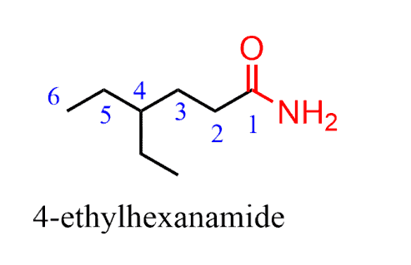
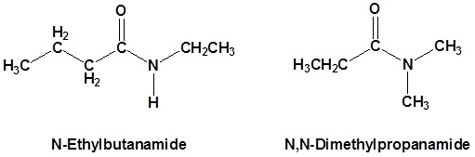
5- Amides
Functional groups
Examples of Amides Names:
Structure | IUPAC Name | Common Name
HCONH₂ | Methanamide | Formamide
CH₃CONH₂ | Ethanamide | Acetamide
CH₃CH₂CONH₂ | Propanamide | Propionamide
CH₃(CH₂)₂CONH₂ | Butanamide | Butyramide
CH₃(CH₂)₃CONH₂ | Pentanamide | Valeramide
CH₃CONHCH₃ | N-Methyl ethanamide | -
CH₃CON(CH₃)₂ | N,N-Dimethyl ethanamide | -
Hello Miss i Hope this message finds you well i just want to Ask if there is a possibility to make the tp session of tomorow after holidays or at least let us came with other groupes because most of us are already home thank you for understanding Saha ftorek .

Slide 43
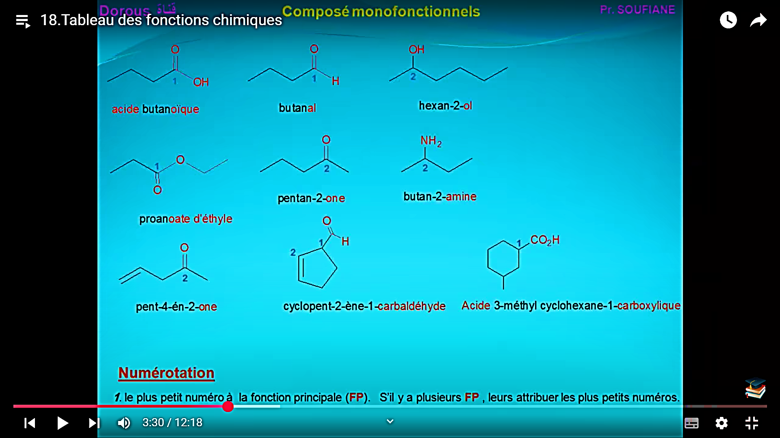
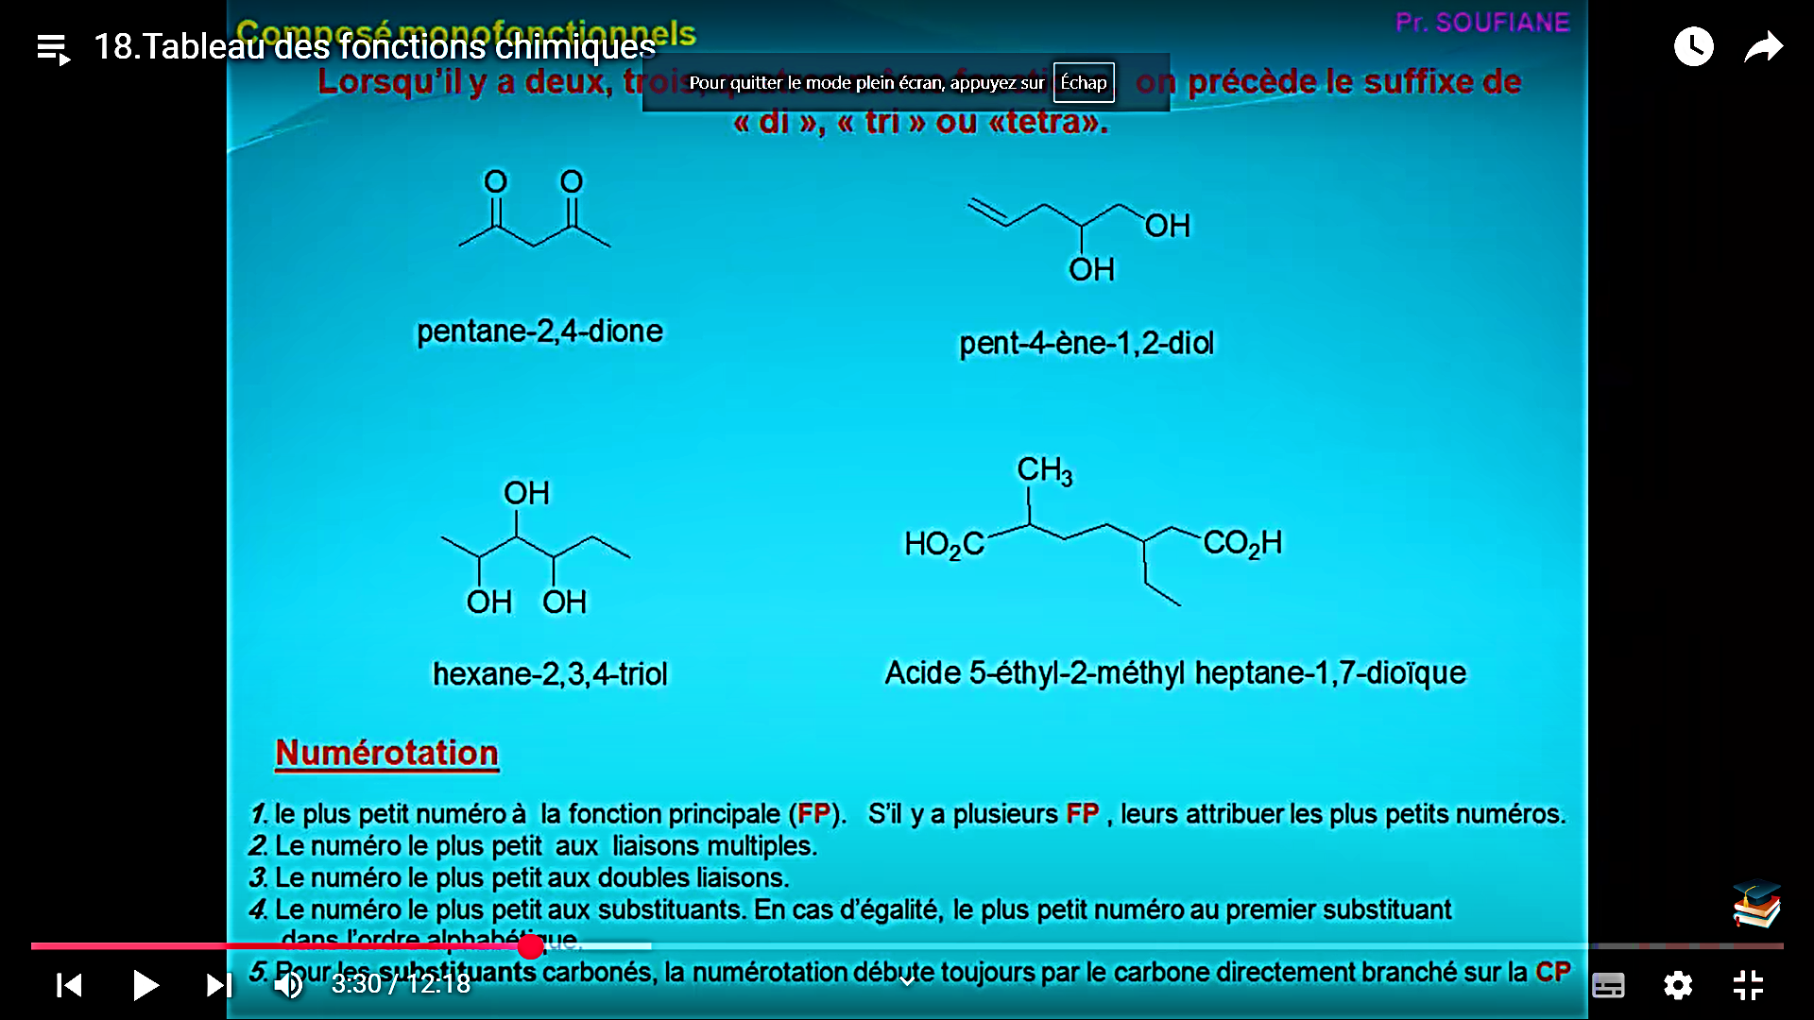
Butanoic acid
Ethyl propanoate
Penta-4-en-2-one
2-Ethyl-5-methylheptane-1,7-dioic acid

Slide 44
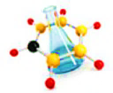
Chapter II: Chemical bonds
Atoms rarely exist in an isolated state (noble gases, hydrogen). They associate to form structures that are more stable than isolated atoms, which can be either molecules or ions.
There are three types of chemical bonds :
Chemical bonds
Covalent Bond
Ionic Bond
Metallic Bond
Single Covalent Bond
Multiple covalent bonds
coordinate covalent bonds
Polar and non polar bonds

Slide 45
Chemical bonds
Reminder
1- Lewis model
The Lewis structure of a molecule is a representation that shows all electron pairs, both bonding and non-bonding.
It closely resembles a structural formula, which already illustrates the bonding pairs, but differs by explicitly including non-bonding electron pairs.
By simply adding these lone pairs to a structural formula, it becomes a complete Lewis representation of the molecule.
الرابطة
غير الرابطة
الصيغة المفصلة
الأزواج الرابطة
أزواج غير المترابطة

Slide 46
Chemical bonds
A- Lewis Diagram of an Atom
In the Lewis model, only valence electrons are considered, as they are responsible for chemical bonding.
Around the atomic symbol, unpaired electrons (single electrons in their quantum orbitals) are represented by dots, while paired electrons (shared or lone pairs) are depicted as lines, forming what is called an electron pair.
This model provides a simple yet effective way to visualize how atoms interact to form stable molecules.
إلكترونات التكافؤ
إلكترونات منفردة
إلكترونات متزاوجة
زوج إلكتروني
Notes:
Autour du symbole atomique, les électrons non appariés (électrons uniques dans leurs orbitales quantiques) sont représentés par des points, tandis que les électrons appariés (paires partagées ou solitaires) sont représentés par des lignes, formant ce que l'on appelle une paire d'électrons.
Ce modèle constitue un moyen simple mais efficace de visualiser la manière dont les atomes interagissent pour former des molécules stables.

Slide 47

Chemical bonds
The Approach is as follows
Identify the valence electrons in the electronic configuration.
Write the electrons in their quantum orbitals.
- Around the chemical symbol, add as many dots as there are unpaired electrons and as many lines as there are electron pairs.
Note: Each atom is surrounded by a number of dots equal to the number of valence electrons.
Notes:
Autour du symbole atomique, les électrons non appariés (électrons uniques dans leurs orbitales quantiques) sont représentés par des points, tandis que les électrons appariés (paires partagées ou solitaires) sont représentés par des lignes, formant ce que l'on appelle une paire d'électrons.
Ce modèle constitue un moyen simple mais efficace de visualiser la manière dont les atomes interagissent pour former des molécules stables.

Slide 48
Chemical bonds
B- Lewis Diagram of a Molecule
The Lewis structure defines how electrons are allocated on or between the atoms of a molecule.
This gives us a certain view of the electronic structure of the molecule through its free doublets, its bonding doublets (σ and π bonds), its vacancies and any single electrons (in the case of radicals).
.
Example:
Note: The Lewis diagram does not represent the spatial arrangement of atoms.
الأزواج الرابطة
أزواج منفردة

Slide 49
Chemical bonds
2- Valence of an Atom The valence of an atom is the number of bonding pairs it forms with its neighbors in a molecule; it is generally the number of electrons missing from its outer shell.
Examples: Here is the valence of the main atoms in the periodic table classification.
Valency Category | Examples
Monovalent Atoms | H, Li, Na, K, F, Cl, Br, I
Divalent Atoms | Be, Mg, Ca, O, S
Trivalent Atoms | B, Al, N, P
Tetravalent Atoms | C, Si

Slide 50

Chemical bonds
3- Electronegativity
Electronegativity is a measure of an atom’s ability to attract electrons towards itself when it forms a chemical bond.
This property influences the polarity of bonds: an atom with high electronegativity attracts the shared electrons more strongly, which can lead to an uneven distribution of charge in the molecule.

Slide 51


Slide 52

I- Covalent Bond
Chemical bonds
1- Single Covalent Bond
A covalent bond is a type of chemical bond in which the atoms in a compound share electrons. A single covalent bond, or merely a single bond, involves the sharing of one pair of electrons, i.e., two electrons. Atoms combine in order to complete their valence (outermost) shell and become stable.
They bond due to strong electrostatic attraction between the bonding electrons and the nuclei of both the atoms. This type of bond is prevalent in alkanes

Slide 53


Slide 54
Chemical bonds
2- Multiple covalent bonds
Multiple covalent bonds refer to the situation where two atoms share more than one pair of electrons. The main types are:
Double Bond:
Consists of one sigma (σ) bond and one pi (π) bond.
Example: The oxygen molecule (O₂) has a double bond.
Triple Bond:
Consists of one sigma (σ) bond and two pi (π) bonds.
Example: The nitrogen molecule (N₂) has a triple bond.
These multiple bonds influence molecular properties by reducing bond length, increasing bond energy, and generally making the molecule more rigid and stable.
Notes:
Ces liaisons multiples influencent les propriétés moléculaires en réduisant la longueur des liaisons, en augmentant l'énergie des liaisons et en rendant généralement la molécule plus rigide et plus stable.

Slide 55


Slide 56

Chemical bonds
3- dative covalent bonds or coordinate covalent bonds:
The dative bond, also called the coordinate bond, is a bond formed between two atoms (a donor atom and an acceptor atom), in which the donor atom provides its covalent electron pair to the acceptor atom, which possesses an electron deficiency.
Notes:
Ces liaisons multiples influencent les propriétés moléculaires en réduisant la longueur des liaisons, en augmentant l'énergie des liaisons et en rendant généralement la molécule plus rigide et plus stable.

Slide 57



Slide 58
Chemical bonds
4- Polar and non polar bonds
A polar bond is characterized by an unequal sharing of electrons between two atoms due to a difference in electronegativity. This creates an asymmetric distribution of electron density, resulting in partial charges (δ⁺ and δ⁻) on either side of the bond, which generates a dipole.
To determine if a bond is polar, follow these main steps:
1-Check the Electronegativity of Each Atom: Use the Pauling scale (or another electronegativity scale) to look up the values for the atoms involved.
2- Calculate the Electronegativity Difference: Subtract the lower value from the higher one.
- If the difference is small (typically less than 0.4–0.5), the bond tends to be non-polar.
- If the difference is significant (greater than about 0.5), the bond will be polar.
3- Barycenter of charges G: A molecule is polar if the center of negative charge G⁻ (associated with the electrons) does not coincide with the center of positive charge G⁺ (associated with the nuclei). This separation generates a net dipole moment.

Slide 59
Chemical bonds
How is a barycenter determined?
In the molecular context, the barycenter generally refers to the central point of the mass or charge distribution. For example, when studying the polarity of a molecule, we consider:
- Barycenter of negative charges (G⁻): This is the mean center of the distribution of negative charges (originating from electrons).
- Barycenter of positive charges (G⁺): This is the mean center of the distribution of positive charges (originating from nuclei).
These barycenters are determined as the "center of gravity" of the respective charges, meaning the weighted average of the positions of the charges involved. The relative positions of G⁺ and G⁻ determine whether the molecule is polar or non-polar.
If the centers of positive charge (G⁺) and negative charge (G⁻) coincide, the molecule is considered non-polar.
If the centers of positive and negative charges do not coincide, the molecule is considered polar.

Slide 60


Chemical bonds
Polar Bonds

Slide 61


Chemical bonds

Slide 62

Chemical bonds
The center of negative charge
Polar Bonds: The water molecule is polar
The center of positiv charge

Slide 63


Chemical bonds
non-polar Bonds: The CO₂ molecule is non-polar
The center of negative charge
The center of positiv charge

Slide 64

In summary
Apolar Bonds
polar Bonds
Ionic bonds

Slide 65
II-Ionic bonds
Chemical bonds
Ionic bonds are chemical bonds formed through the complete transfer of one or more electrons from one atom to another. Typically, this occurs between a metal and a nonmetal. Here’s how it works:
Electron Transfer: The metal atom loses electrons to become a positively
charged ion (cation), while the nonmetal gains those electrons to become a negatively charged ion (anion).
- Electrostatic Attraction: The oppositely charged ions are attracted to each other, and this strong electrostatic force holds them together in an ionic compound.
For a bond to be considered ionic, the difference in electronegativity between the two atoms should generally exceed 1.7.
For example: sodium chloride (NaCl), sodium has an electronegativity of about 0.93, and chlorine has an electronegativity of about 3.16. The difference, approximately 2.23, is well above 1.7, which indicates that the bond has a predominantly ionic character.

Slide 66




II-Ionic bonds
Chemical bonds

Slide 67

III-metallic bond
Chemical bonds
A metallic bond is a type of chemical bond in which a ‘cloud’ of free moving valence electrons is bonded to the positively charged ions in a metal.
It can be described as the sharing of free electrons among a lattice of positively charged metal ions.
The structure of metallic bonds is entirely different from that of ionic and covalent bonds. Metal is the only substance that contains a metallic bond
Metallic bonding happens between metals and metals
The metal atoms lose their extra electrons on the outer shell
Metal atoms become positive metal ions
The extra electrons form a sea of electrons around the metal ions

Slide 68


III-metallic bond
Chemical bonds
Properties of Metals
Electrical conductivity
Metals are good conductors of electricity since they have a sea of delocalised electrons (they are free to move). The electrons can move to carry the charge (electricity) from one end of the substance to the other.
Thermal conductivity
Metals are good conductors of heat since the ions are tightly packed and arranged in a regular pattern. Heat is just the vibration of molecules. When molecules heat up, they start to vibrate more and more. Heat travels through the substance by the particles bumping into and vibrating the ones next to them. This vibration passes through the substance, quickly heating up the whole of the substance.

Slide 69
III-metallic bond
Chemical bonds
Properties of Metals
High melting and boiling points
The force felt between the negative sea of delocalised electrons and the positive metal ions is called the electrostatic force. This force is very strong and requires a lot of heat to overcome. For this reason, metals usually have high melting and points! Making them solid at room temperature (normally).
Malleability
If something is malleable, it just means that it can be easily moulded, bent, hammered or rolled into a different shape. Metals are malleable since the atoms are arranged in a regular pattern that can easily slide over each other!

Slide 70

III-metallic bond
Chemical bonds
Properties of Metals
Alloys
A lot of the time, people want some properties of metals but not others. The most common example is that the strength and conductivity of metals is very useful when building bridges/machinery (etc) but the malleability is not wanted To solve this, alloys can be made.
This is just where another type of atom is introduced into the metallic structure to jumble up the atoms. (If the atoms aren’t in a regular pattern anymore, they can’t easily slide over each other!)
Carbon is a common example of the added substance:

Slide 71

Les liaison chimique
Voir quelque notion importante

Slide 72
Electrochemistry
Introduction:
Electrochemistry is a discipline that studies the relationship between chemical transformations and the flow of electric current.
Its field of application is extremely broad:
production of electrical energy from chemical reactions (batteries and accumulators),
carrying out chemical reactions (analytical electrochemistry),
determination of mechanisms and reaction kinetics (organic electrochemistry, corrosion),
development of devices (batteries and sensors), etc.
The study of electrochemical reactions requires knowledge from various fields of chemistry and physics: thermodynamics, kinetics, transport phenomena, electricity, etc.

Slide 73

Electrochemistry
II-chemical reaction
A chemical reaction usually involves either releasing or absorbing heat ( this is called the thermal effect of the reaction).
Here are some key features of a typical chemical reaction:
The reacting particles must come into direct contact.
Electrons move over very short distances, directly between atoms or molecules.
- The reaction can happen anywhere the particles meet and collide.
Notes:
Une réaction chimique implique généralement soit un dégagement, soit une absorption de chaleur — c'est ce qu'on appelle l'effet thermique de la réaction. Voici quelques caractéristiques clés d'une réaction chimique typique :
Les particules réactives doivent entrer en contact direct.
Les électrons se déplacent sur de très courtes distances, directement entre les atomes ou les molécules.
La réaction peut se produire partout où les particules se rencontrent et entrent en collision.

Slide 74

Electrochemistry
III-Electrochemical Reaction:
For energy changes to appear in the form of electrical energy, the reaction conditions must be modified. The production of electrical energy = circulation of electric current = flow of electrons in a unidirectional transfer.
1- The production of electrical energy = circulation of electric current = flow of electrons in a unidirectional transfer.
2- The reacting particles are not in direct contact with each other- they are spatially separated. This means that one or more electrons must be transferred from one reacting species to another.
For example:
Zn²⁺ + 2e⁻ → Zn (reduction)
Cu → Cu²⁺ + 2e⁻ (oxidation)
Overall reaction: Cu²⁺ + Zn → Cu + Zn²⁺
Notes:
| Réaction chimique classique | Réaction électrochimique |
| ---------------------------- | ------------------------------------- |
| Réactifs en contact direct | Réactifs séparés dans deux électrodes |
| Échange d’électrons localisé | Électrons transférés via un circuit |
| Pas de courant électrique | Production d’un courant électrique |

Slide 75
Electrochemistry
An electrochemical system includes:
Two metal pieces called electrodes:
Anode: site of oxidation (loss of electrons)
Cathode: site of reduction (gain of electrons)
An electrolyte, which is an ionic conductor (it allows ions to move).
The reacting chemical species.
What happens in an electrochemical process? It involves electron transfer across an electrochemical interface (that is, where the electronic conductor (electrode) meets the ionic conductor (electrolyte)).
At this interface:
An oxidizing species (A) gains electrons → it is reduced: A (oxidant) + n e⁻ → A (reduced form)
A reducing species (A) loses electrons → it is oxidized: A (reductant) – n e⁻ → A⁺ (oxidized form)
The species that undergo oxidation or reduction are called electroactive species.
The anode is where oxidation occurs.
The cathode is where reduction occurs.
Notes:
Il implique un transfert d’électrons à travers une interface électrochimique — c’est-à-dire là où le conducteur électronique (électrode) rencontre le conducteur ionique (électrolyte).
À cette interface :
Une espèce oxydante (A) gagne des électrons → elle est réduite : A (oxydant) + n e⁻ → A (forme réduite)
Une espèce réductrice (A) perd des électrons → elle est oxydée : A (réducteur) – n e⁻ → A⁺ (forme oxydée)
Les espèces qui subissent une oxydation ou une réduction sont appelées espèces électroactives.
L’anode est le lieu où se produit l’oxydation.
La cathode est le lieu où se produit la réduction.

Slide 76
Electrochemistry
VI- Electrolytic Dissociations:
a- Concept of Solvent and Solute: The solvent is the species present in the largest amount (in terms of moles) compared to the other substances, which are called solutes.
There are electrolytic solutes, which conduct electric current, and non-electrolytic solutes, which do not contribute to electrical conductivity.
We distinguish between:
Strong electrolytes, which dissociate completely in solution, and Weak electrolytes, which dissociate only partially.
For example: Potassium nitrate (KNO₃), lithium perchlorate (LiClO₄), and hydrochloric acid (HCl) are strong electrolytes in aqueous solution, meaning they fully dissociate into ions: HCl + H₂O → H₃O⁺(aq) + Cl⁻(aq)
Acetic acid (CH₃COOH) is a weak electrolyte because its dissociation in water is only partial: CH₃COOH + H₂O ⇌ CH₃COO⁻(aq) + H₃O⁺(aq)
Methanol (CH₃OH) and glucose (C₆H₁₂O₆) are non-electrolytes in aqueous solution because they do not produce ions through reaction with water: CH₃OH + H₂O → CH₃OH(aq)
Notes:
II) – Dissociations électrolytiques :
II-1) – Notion de solvant et de soluté :
Le solvant est l’espèce présente en plus grande quantité (en moles) par rapport aux autres substances, appelées solutés.
Il existe :
des solutés électrolytiques, qui conduisent le courant électrique,
et des solutés non électrolytiques, qui ne contribuent pas à la conductivité électrique.
On distingue :
les électrolytes forts, qui se dissocient complètement en solution,
et les électrolytes faibles, qui ne se dissocient que partiellement.
Exemples :
Le nitrate de potassium (KNO₃), le perchlorate de lithium (LiClO₄) et l’acide chlorhydrique (HCl) sont des électrolytes forts en solution aqueuse, ce qui signifie qu’ils se dissocient totalement en ions : HCl + H₂O → H₃O⁺(aq) + Cl⁻(aq)
L’acide acétique (CH₃COOH) est un électrolyte faible, car sa dissociation dans l’eau est partielle : CH₃COOH + H₂O ⇌ CH₃COO⁻(aq) + H₃O⁺(aq)
Le méthanol (CH₃OH) et le glucose (C₆H₁₂O₆) sont des non-électrolytes en solution aqueuse, car ils ne produisent pas d’ions par réaction avec l’eau : CH₃OH + H₂O → CH₃OH(aq) (Remarque : cette équation montre simplement la dissolution du méthanol, sans réaction chimique ni dissociation.)

Slide 77

Electrochemistry
b-Formation of an electrolytic solution
he dissolution of an electrolyte in water follows three main steps:
1. Breaking up the solid (dissociation)
The particles (ions) of the ionic solid are separated from
each other. Example: NaCl dissociates into Na⁺ and Cl⁻. his requires energy.
2. Solvation (or hydration)
The water molecules surround the released ions.
Cations are attracted to the oxygen of water (negative pole).
Anions are attracted to the hydrogens (positive pole). This stabilizes the ions in solution and releases energy.
3. Dispersion of ions in the solution
The solvated ions (surrounded by water) disperse evenly throughout the liquid. The solution becomes conductive because the ions can move freely.

Slide 78


Electrochemistry
C-Importance of the Polar Nature of the Solvent:
A molecule has a non-zero dipole moment when the center of positive charges (q⁺) does not coincide with the center of negative charges (q⁻).
Note that: |q⁺| = |q⁻| = q. Let d be the distance between these two centers of charge
Fig. 1: Dipole moment μₐ of a molecule A–B.
Let $\vec{μ_{d}}$ be the dipole moment of a bond A–B.
This dipole moment is a function of the charge of the dipole and the distance d between the positive and negative charges:
$\vec{μ_{d}}$ = q × d
It is expressed in C·m (coulomb-meter) or in Debye (D), with: 1 D = (1/3) × 10⁻²⁹ C·m
Notes:
Pourquoi un solvant polaire est important pour dissoudre des ions ?
Ions = charges électriques Les ions sont des particules chargées (positives ou négatives). Pour les dissoudre, il faut que le solvant puisse interagir efficacement avec ces charges.
Solvant polaire = dipôle électrique Un solvant polaire, comme l’eau, a un moment dipolaire : ses molécules ont une séparation de charges positives et négatives.
Cela permet aux molécules de solvant d’attirer et de stabiliser les ions en solution.
Par exemple, la partie négative de la molécule d’eau entoure un ion positif (Na⁺), et la partie positive entoure un ion négatif (Cl⁻).
Solvant apolaire = pas de charges séparées Un solvant apolaire (exemple : hexane) n’a pas de charges partielles ni de moment dipolaire.
Il ne peut pas solvater les ions efficacement.
Résultat : les ions ne se dispersent pas bien, donc l’électrolyte ne se dissout pas.

Slide 79
Electrochemistry
d-Ionization Process:
It is the process by which a solute such as KCl or CH₃COOH is transformed into an ion pair by the solvent (H₂O). For this to happen, the solvent molecule must be polar.
Depending on the type of electrolyte, we can define a quantity called the degree of dissociation:
α=n/N
n: number of moles dissociated
N: total number of moles
Interpretation of α:
α = 0: the substance is not dissociated (non-electrolyte)
α = 1: complete dissociation (strong electrolyte)
0 < α < 1: partial dissociation (weak electrolyte)

Slide 80
Electrochemistry
Relationship Between the Degree of Dissociation α and the Equilibrium Constant K:
When a weak electrolyte, such as a weak acid, dissolves in water, it does not fully dissociate.
Some molecules remain intact, while others dissociate into ions. To describe this process quantitatively, we use two important parameters:
Degree of dissociation α: the fraction of molecules that dissociate.
Equilibrium constant K: a chemical characteristic that expresses the balance between dissociated and undissociated forms.
Step 1: The Dissociation Reaction
Consider a weak acid HA dissociating according to:
HA⇌H⁺+A⁻

Slide 81

Electrochemistry
Step 2: Concentrations at Equilibrium
Initially, the solution contains a concentration C mol/L of HA.
After dissociation, a fraction α of the molecules dissociates into ions.
We can summarize the concentrations as:
The value of the constant K is therefore closely related to the production of each species present in the solution when the system has reached its equilibrium point.
K > 1: the reaction is shifted in the forward direction (towards the formation of products).
K < 1: the reaction is shifted in the reverse direction (towards the formation of reactants).
K >> 1: the reaction can be considered complete (the reactants are then almost entirely converted into products).
Species | Initial Concentration | Concentration at Equilibrium
HA | C | C(1−α)
H+ | 0 | Cα
A− | 0 | Cα
Step 3: Definition of the Equilibrium Constant
The equilibrium constant K is defined by the law of mass action as:

Slide 82

Electrochemistry
Step 4: Expressing K in Terms of α
Substituting the equilibrium concentrations, we get:
his equation links the equilibrium constant K, the initial concentration C, and the degree of dissociation α. It allows us to:
Calculate α from known values of K and C, to find out how much of the electrolyte dissociates.
Determine K from experimental data on α.

Slide 83


Electrochemistry
V- Electrical Properties of Solutions:
a- Under Direct Current (Electrolysis):
Electrolysis is a chemical reaction resulting from a potential difference applied to the electrodes (an electrochemical reaction).
Faraday (1834) established a relationship between the amount of chemical species formed at the electrode and the quantity of charge passed during electrolysis. 1 Faraday (F) = 96,500 Coulombs (C).
Examples:

Slide 84

Electrochemistry
Where:
m: mass of the substance deposited or released (in grams),
M: molar mass (g/mol),
Q: total charge (in coulombs),
n: number of electrons involved per ion or molecule,
F: Faraday’s constant (96,485 C/mol).
V- Electrical Properties of Solutions:
a- Under Direct Current (Electrolysis):
Electrolysis is a chemical reaction resulting from a potential difference applied to the electrodes (an electrochemical reaction).
Faraday (1834) established a relationship between the amount of chemical species formed at the electrode and the quantity of charge passed during electrolysis. 1 Faraday (F) = 96,500 Coulombs (C).
Faraday’s Law:
It simply states that the mass mof a species produced or consumed at an electrode is proportional to the electric charge Q passed through the electrolyte:

Slide 85

Electrochemistry
B – Measuring Conductivity with Alternating Current
The electrical conductivity of a solution can be measured using a setup that applies an alternating current (AC).
Unlike direct current (DC), which can induce electrolysis reactions, alternating current does not cause chemical transformations.
The measurement device typically consists of two identical electrodes (same material, shape, and surface area) placed at a fixed distance from each other within the solution.
By applying an alternating voltage U and measuring the current I, the resistance R of the solution can be calculated using Ohm’s law:
U=R⋅I
This resistance depends on several factors: the nature and concentration of the ions present, the temperature, the distance l between the electrodes, their surface area S, and the resistivity ζ of the solution.
The relationship is given by:

Slide 86

Electrochemistry
B – Measuring Conductivity with Alternating Current
By applying an alternating voltage U and measuring the current I, the resistance R of the solution can be calculated using Ohm’s law:
The greater the resistivity (ρ), the more the material resists the flow of current.
Increasing the distance l between electrodes increases resistance.
Increasing the electrode surface area S decreases resistance.
U=R⋅I
This resistance depends on several factors:
the nature and concentration of the ions present,
the temperature,
the distance l between the electrodes,
surface area S,
the resistivity ζ of the solution.
The relationship is given by:
Where:
R = resistance (in ohms, Ω)
ρ = resistivity of the material (in Ω·m)
l = length (distance between the electrodes)
S = cross-sectional area (surface of the electrodes in contact with the solution)

Slide 87


Electrochemistry
B – Measuring Conductivity with Alternating Current
From this, two important electrical quantities can be defined:
Conductance C, which is the inverse of resistance and is expressed in Siemens (S):
Conductivity (χ , x or σ) (also called volumetric conductivity), which is expressed in S·m⁻¹ or S·cm⁻¹, and calculated by:
It represents the ability of a material to conduct electric current.

Slide 88


Electrochemistry
B – Measuring Conductivity with Alternating Current
Conductivity χ is related to conductance and the geometry of the measurement cell:
Where:
l= distance between electrodes (cm)
S = surface area of the electrodes (cm²)
Since current I is the rate of charge flow:
Substitute into the conductivity expression:
Where:
χ = conductivity (S·cm⁻¹)
Q = electric charge (Coulombs)
t= time (seconds)
U= voltage (Volts)
l= distance between electrodes (cm)
S = surface area of electrodes (cm²)

Slide 89
Electrochemistry
Exercise: Electrolysis of CuCl₂ (Copper(II) Chloride)
An aqueous solution of CuCl₂ is electrolyzed using inert electrodes (graphite) in a beaker. A constant current of I = 1.50 A is applied for 30 minutes. At the end of the electrolysis, 0.82 g of metallic copper is collected on the cathode. Useful data: M(Cu) = 63.5 g/mol, F = 96,500 C/mol
Write the electrode half-reactions.
Calculate the total charge Q supplied during the electrolysis.
Determine the theoretical amount (in moles) of copper that should have been deposited if the yield was 100%.
Calculate the corresponding theoretical mass of copper.
Determine the actual Faradaic efficiency of the process.
Suggest two possible reasons why the efficiency is below 100%.

Slide 90
Electrochemistry
Exercise: Degree of Dissociation of a Weak Acid
A quantity of 0.1 mol of acetic acid (CH₃COOH) is dissolved in 1 liter of water. At equilibrium, the concentration of H₃O⁺ ions measured by pH-metry is 1.34 × 10⁻³ mol/L.
The dissociation equation is: CH₃COOH + H₂O ⇌ CH₃COO⁻ + H₃O⁺
Data:
Initial concentration of CH₃COOH: 0.1 mol/L, [H₃O⁺] at equilibrium = 1.34 × 10⁻³ mol/L
Volume of solution: 1 L
Calculate the degree of dissociation α of the acid.
Determine the acid dissociation constant Kₐ.
Is the calculated value of Kₐ consistent with the known value for acetic acid: 1.8 × 10⁻⁵?
What would the value of α be if the solution were 10 times more dilute (0.01 mol/L)? Assume the acid remains weak.

Slide 91
Electrochemistry
Exercise: Electrolysis of AgNO₃ (aq)
An electrolysis is performed on an aqueous solution of silver nitrate (AgNO₃) using two inert electrodes (platinum), applying a constant current of 2.80 A for 30 minutes.
Data: Molar mass of Ag = 107.9 g/mol Faraday constant = 96500 C/mol
Voltage applied = 5.0 V , Efficiency (yield) of silver deposition = 90%
Molar volume of gases at STP = 22.4 L/mol
Questions:
Write the half-reactions at the electrodes and the overall equation for the electrolysis.
Calculate the total electric charge Q passed during the electrolysis.
Calculate the theoretical mass of silver that can be deposited.
Taking into account the efficiency, calculate the actual mass of silver deposited.
What is the volume of gas evolved at the anode? (Assume oxygen gas evolution from water oxidation.)
Calculate the electrical energy consumed in joules during the electrolysis.
Compare with the case where silver electrodes are used: what would change regarding the electrochemical reactions and the metal deposition?

Slide 92


Electrochemistry
VI-Molar Conductivity (Ωₘ)
To easily compare different electrolytes (strong or weak), molar conductivity is defined as the ratio of the conductivity of the solution to its concentration:
where:
Ω_{𝑚} is the molar conductivity in S·m²·mol⁻¹,
𝜎 is the conductivity in S·m⁻¹,
𝑐 is the electrolyte concentration in mol·L⁻¹. Note: Molar conductivity varies with concentration.
When the concentration approaches zero (very dilute solution), the molar conductivity approaches a limiting value called the molar conductivity at infinite dilution, denoted :

Slide 93


Electrochemistry
Kohlrausch’s Law (1900):
Kohlrausch experimentally showed that for certain electrolytes (the strong electrolytes) the plot of Ω_{m} versus √c linear at low concentrations.
This observation allowed scientists to distinguish between:
- Strong electrolytes, which show a linear decrease of Ω_{m} with √c ​,
- Weak electrolytes, for which this linear behavior does not apply.
This equation is not valid for weak electrolytes, because they are not fully dissociated in solution, even at low concentrations.
Debye-Hückel-Kohlrausch Equation:
Later, Debye and Hückel provided a mathematical expression for this experimental observation, valid for strong electrolytes:
where:
Ωm: molar conductivity at concentration c,
: molar conductivity at infinite dilution,
k: a constant depending on the electrolyte and temperature.
Notes:
Kohlrausch a montré expérimentalement que pour certains électrolytes (les électrolytes forts), le tracé de Ωm en fonction de √c est linéaire à faible concentration.Cette observation a permis aux scientifiques de faire la distinction entre- Les électrolytes forts, qui présentent une diminution linéaire de Ωm avec √c ,- Les électrolytes faibles, pour lesquels

Slide 94
Electrochemistry
Explanation of the Debye-Hückel Behavior of Electrolytes
This equation shows that the conductivity of an electrolyte decreases as its concentration increases. This effect can be understood by considering that the movement of an ion under the influence of an electric field is slowed down by the surrounding ionic atmosphere.
This ionic atmosphere has a relaxation time, meaning it takes a moment to rearrange itself after an ion moves (this slows the migration of ions).
👉 The greater the ionic strength of the solution (i.e., the more ions present), the less conductive the electrolyte becomes. This explains why conductivity doesn't simply increase with more ions (their interactions start to interfere).
Notes:
Cette équation montre que la conductivité d'un électrolyte diminue lorsque sa concentration augmente.
Cet effet peut être compris en considérant que le mouvement d'un ion sous l'influence d'un champ électrique est ralenti par l'atmosphère ionique environnante.
Cette atmosphère ionique a un temps de relaxation, c'est-à-dire qu'elle met un moment à se réarranger après le déplacement d'un ion (ce qui ralentit la migration des ions).
👉 Plus la force ionique de la solution est élevée (c'est-à-dire plus il y a d'ions présents), moins l'électrolyte est conducteur. Cela explique pourquoi la conductivité n'augmente pas simplement avec le nombre d'ions (leurs interactions commencent à interférer).

Slide 95


Electrochemistry
Determination of the Degree of Dissociation α

Slide 96

Electrochemistry
The Parameter k
The constant k in the Debye-Hückel-Kohlrausch equation depends on the stoichiometry of the electrolyte (how many ions are released per molecule), not on its specific chemical nature.
Limiting Molar Conductivity

Slide 97

Electrochemistry
VII- Chemical Activity of a Species in Solution

Slide 98




Electrochemistry
Special Cases:
Ideal Solution: No correction is needed,
so activity equals
concentration:
Real Solutions: The available concentration is lower than the added concentration:
Dilute Solutions (typically C≤10⁻³ mol·L⁻¹): The solution behaves nearly ideally; activity can be approximated by concentration:

Slide 99
Electrochemistry
V III- Debye–Hückel Theory
In 1923, the physicists Peter Debye (1884–1966) and Erich Hückel (1896–1980) proposed a theoretical model to explain the non-ideal behavior of strong electrolytes in dilute solutions. This theory marks a foundational step in physical chemistry and electrochemistry, as it introduced a mathematical framework to quantify ionic interactions in solution.
Context and Assumptions
Unlike weak electrolytes, strong electrolytes are considered to be fully dissociated into their ions in aqueous solutions. However, their experimental behavior often deviates from the predictions of ideal solution theory. Debye and Hückel proposed that these deviations arise due to long-range electrostatic interactions between oppositely charged ions, rather than from chemical association or molecular interactions like van der Waals forces.
In a truly ideal solution, ions are uniformly and randomly distributed, and their interactions are negligible. In reality, however, each ion is surrounded by an "ionic atmosphere" of oppositely charged ions, which affects its behavior in the solution.

Slide 100

Electrochemistry
Debye–Hückel Limiting Law

Slide 101

Electrochemistry

Slide 102


Electrochemistry
IX- ionic mobility
Experimental Setup
movement of ions in an electric field

Slide 103


Electrochemistry
Ion Velocity

Slide 104


Electrochemistry

Slide 105

Electrochemistry
X.Transport Number t_{i}
The transport number t_{i} of an ion i represents the fraction of the total electric current carried by that ion in an electrolytic solution.
General formula:

Slide 106
Electrochemistry
The Three Modes of Transport for Species in Solution
When an electrochemical reaction occurs, the species present in the solution can move toward the electrodes through three mechanisms:
1. Convection:
Mechanism: Overall movement of the liquid caused externally (e.g., stirring, forced circulation, rotating electrode).
Affected species: All species, whether charged or not.
Purpose: To homogenize the solution and avoid ion accumulation near the electrodes.
2. Diffusion:
Mechanism: Movement of species from high concentration to low concentration.
Cause: A concentration gradient, i.e., a gradient in chemical potential.
Affected species: Electroactive species, whether charged or neutral.
Example: If the concentration of an ion decreases near the electrode due to reduction, it diffuses toward the electrode from the bulk solution.
3. Migration:
Mechanism: Movement of ions under the effect of an electric field.
Cause: An electrostatic potential gradient in the solution.
Affected species: Only charged species (whether electroactive or not).
Example: Positive ions (cations) migrate toward the cathode (–), negative ions (anions) toward the anode (+).

Slide 107

Electrochemistry
Ion | H⁺ | Na⁺ | K⁺ | Fe²⁺ | Fe³⁺ | OH⁻ | NO₃⁻ | Cl⁻
u⋅10⁸u (m²·V⁻¹·s⁻¹) | 36.3 | 5.2 | 7.6 | 5.4 | 6.8 | 20.6 | 7.4 | 7.9

Slide 108

Electrochemistry

Slide 109

Electrochemistry

